Slide 1
Causes of Infant Mortality and Morbidity
Mr. Vijay Sansare
Assistant Professor

Slide 2
Infant Mortality
The death of children under the age of one year.
Infant mortality rate (IMR) is the number of deaths per 1,000 live births of children under one year of age.
The rate for a given region is the number of children dying under one year of age, divided by the number of live births during the year, multiplied by 1,000.

Slide 3
WHO, 2016
Globally, the infant mortality rate has decreased from an estimated rate of 64.8 deaths per 1000 live births in 1990 to 30.5 deaths per 1000 live births in 2016.
Annual infant deaths have declined from 8.8 million in 1990 to 4.2 million in 2016.
Among Empowered Action Group (EAG) states and Assam, all states except Uttarakhand have reported decline in IMR compared to 2015.

Slide 4
Infant Mortality Rate in India 2017
September 29, 2017.
According to recently released Sample Registration Bulletin (SRS), India has registered a significant decline of 8% in Infant Mortality Rate (IMR) in 2016.
IMR in India has declined by three points from 37 per 1000 live births in 2015 to 34 per 1000 live births in 2016

Slide 5
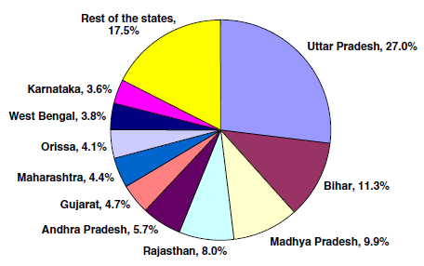

Slide 6
Causes Infant Mortality
The most recent data on causes of child deaths in India are from the latest SRS report.
Amongst all under 5 deaths,
after Perinatal conditions (33.1%);
Respiratory infections (22.0%),
Diarrheal disease (14%) are the most common causes of deaths (Fig. 7).
It is notable that unintentional injuries (3.2%) contribute more deaths than that by nutritional deficiencies (2.8%),
Congenital anomalies (2.7%) or malaria (2.7%). It is noticeable that proportion

Slide 7
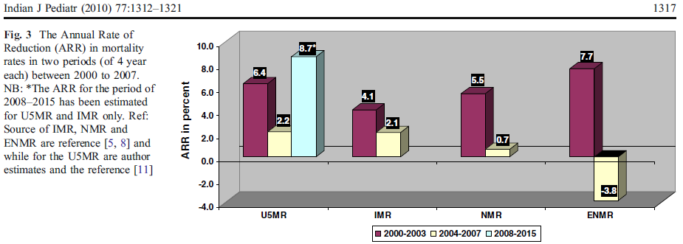

Slide 8
Morbidity
The morbidity means "the quality of being unhealthful."
Morbidity comes from the word morbid, which means "or of relating to disease," like the number of cases of any disease in an areas — morbidity rates for polio that plummeted in the 20th century.

