Slide 1
Children in Need of Care and Protection
Mr. Vijay Sansare
Assistant Professor

Slide 2
Vulnerable Children
All children due to their age are considered to be at risk for exploitation, abuse, violence and neglect.
But vulnerability cannot be defined simply by age.
Though age is one component, Vulnerability is also measured by the child's capability for self-protection.
The question that arises is, are children capable of protecting themselves.
Can children provide for their basic needs, defend against a dangerous situation or even recognise a dangerous situation is developing?

Slide 3
Vulnerable Children
A child's vulnerability comes from various factors that hinder a child's ability to function and grow normally.
vulnerability of children is further compounded by the following factors:
Age within age
Physical disabilities
Mental disabilities
Provocative behaviours
Powerlessness
Defencelessness
Passivity
Illness
Invisible

Slide 4
The Integrated Child Protection Scheme (ICPS) like the Juvenile Justice Act, 2000
ICPS and JJA, defines vulnerability in two categories: children in need of care and protection and children in conflict with law.
Children in need of care and protection is defined as a child who: Doesn't have a home or shelter and no means to obtain such an abode Resides with a person(s) who has threatened to harm them and is likely to carry out that threat, harmed other children and hence is likely to kill, abuse or neglect the child.
Is mentally or physically handicapped, or has an illness, terminal or incurable disease and has no one to provide and care for him/her.

Slide 5
The Integrated Child Protection Scheme (ICPS) like the Juvenile Justice Act, 2000
Has a parent or guardian deemed unfit or unable to take care of the child.
Is an orphan, has no family to take care of him/her, or is a runaway or missing child whose parents cannot be located after a reasonable search period.
Is being or is likely to be sexual, mentally, emotionally or physically abused, tortured or exploited.
Is being trafficked or abusing drug substances.
Is being abused for unthinkable gains or illegal activities.
Is a victim of arm conflict, civil unrest or a natural disaster.

Slide 6
Facts and Figures about children
Total number of children in India: 440 million
Children in difficult circumstances:
About 172 million or 40 per cent children.
These children include:
Children without family support,
Children forced into labour,
Abused/trafficked, children on streets,
Children affected by substance abuse,
children in armed conflict/civil unrest/natural calamity etc.

Slide 7
Children living on Streets
Street children or children living and working on the streets are a common sight yet exact numbers are not known.
About 50,923 (1 % of the total number of children in Delhi) children are living and working on streets of Delhi.
Almost 50 % migrant children in Delhi did not want to go back to their place of origin.
About 67.3 % children felt they were in danger on the streets. (Study: Surviving the Streets (2011) Save the children study).

Slide 8
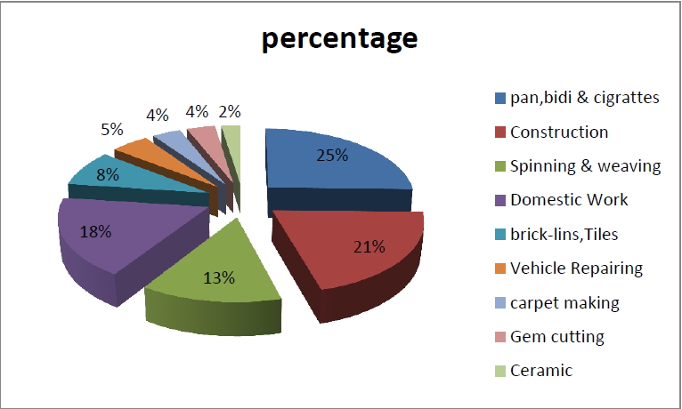
The occupation wise distribution of children engaged in hazardous occupation as per census of India 2001 is shown below

Slide 9
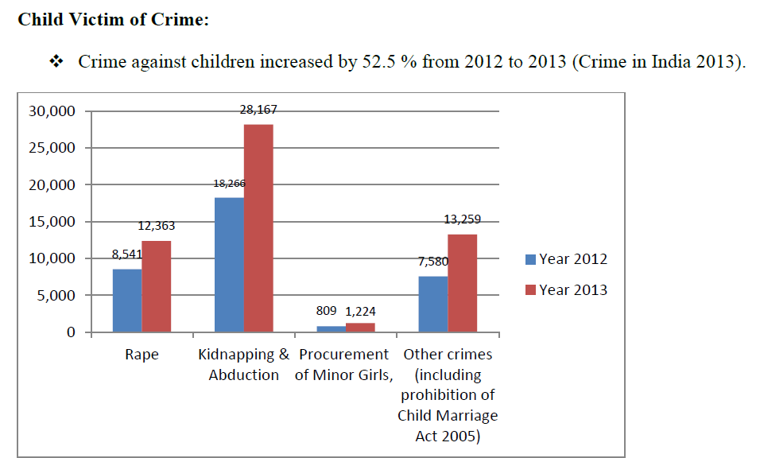

Slide 10
Victims of Child Abuse The Study on child abuse by MWCD in 2007 with 12447 respondents stated the following forms of abuse

Slide 11
Child Trafficking
Child trafficking could be for:
Sexual exploitation
Illegal activities
Labour
Entertainment and sports
Adoption
Marriage

Slide 12
Child Trafficking
It is estimated that half a million children have been abducted and forced to work in India's cities.
About 200,000 persons are trafficked into, within or through India every year ( US State Department).
According to NHRC Report, only 10 % of human trafficking in India is international, while almost 90% is interstate
NCRB reported 65,038 missing children in the country in 2012.
NCRB reported that in 2004, as many as 2,265 cases of kidnapping and abduction of children qualified as forms of trafficking and were reported to the police.
Of these, 1,593 cases were of kidnapping for marriage, 414 were for illicit sex, 92 for unlawful activity, 101 for prostitution and the rest for various other things like slavery, beggary and even selling body parts.

Slide 13
Child Trafficking
Most of these children (72 per cent) were between 16 and18 years of age.
Twenty-five per cent were children aged 11-15 years.
child prostitution through abduction is estimated to be 40 percent.
The total percentage of Devadasis is 80 percent of the total number in prostitution.
About 5 percent of the children come after the incidence of Rape.
About 8 percent of children come to prostitution because of the incidence of Incest.
About 10 percent of child prostitutes are children of prostitutes.

Slide 14
Child in Conflict with Law
Children in Conflict with Law (CCL) (IPC Crimes) have increased by 13.6 per cent over 2012. (31,725 cases were registered in 2013 against 27,936 cases in 2012).
Decrease of cases was observed under the crime head Counterfeiting, Arson, Riots, Dowry Deaths, Cheating and Dacoity in 2013 over 2012.
Increase in incidents was found under the head: 'Assault on Women with intent to outrage her modesty' (132.3 %) followed by 'insult to the modesty of women' (70.5 %)and 'rape' (60.3 %).

Slide 15
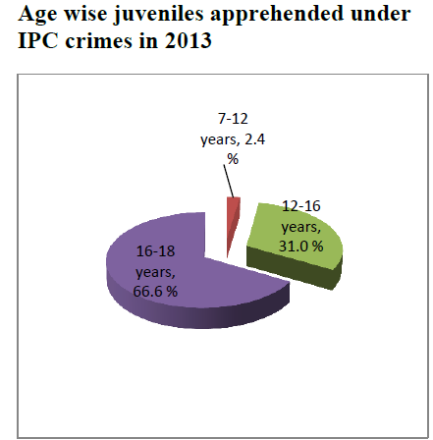

Slide 17
https://womenchild.maharashtra.gov.in/contentmi/innerpage/policies-ma.php
http://www.childlineindia.org.in/vulnerable-children.htm
National Institute of Public Cooperation and Child Development, 5, Siri Institutional Area, Hauz Khas, New Delhi- 110016

