Slide 2
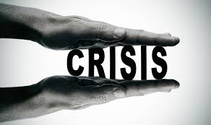
Crisis संकट
Mr. Vijay Sansare
Assistant Professor

Slide 3
Crisis संकट
A crisis (from the Greek κρίσις - krisis; plural: "crises"; adjectival form: "critical") is any event that is going (or is expected) to lead to an unstable and dangerous situation affecting an individual, group, community, or whole society.

Slide 4
Crisis संकट
A crisis might take many forms: moving house in exam week, being robbed, harassed or assaulted, facing illness or death, or losing your job.
Sometimes a crisis situation can be triggered by internal stressors such as depression with negative self talk.
In each case a crisis is an event which demands your attention.

Slide 5
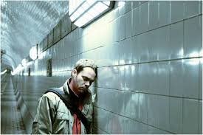
Crisis संकट
“…crisis is a perception or experience of an event or situation as an intolerable difficulty that exceeds the person’s current resources and coping mechanisms.” (James and Gilliland, 2001)

Slide 6
Crisis संकट
“…an upset in equilibrium at the failure of one’s traditional problem-solving approach which results in disorganization, hopelessness, sadness, confusion, and panic.” (Lillibridge and Klukken, 1978)

Slide 7
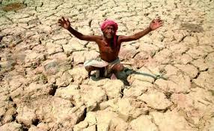
Crisis संकट
“People are in a state of crisis when they face an obstacle to important life goals—and obstacle that is, for a time, insurmountable अनुल्लंघनिय by the use of customary methods of problem-solving.” (Caplan, 1961)

Slide 8
Types of Crisis
Developmental crises occur as part of the process of growing and developing through various periods of life.
Erikson’s Stages of Psychosocial Development

Slide 9
Types of Crisis
Situational crises are sudden and unexpected, such as accidents and natural disasters.
Getting in a car accident, experiencing a flood or earthquake, or being the victim of a crime are just a few types of situational crises.

Slide 10
Types of Crisis
Existential crises are inner conflicts related to things such as life purpose, direction, and spirituality.
A midlife crisis is one example of a crisis that is often rooted in existential concerns.

Slide 11
Crisis संकट Reactions
Increase or decrease in activity level
Decreased social activities
Increased relationship conflict
Diminished work performance

Slide 12
Crisis संकट Reactions
Increased substance use
Difficulties sleeping
Change in eating patterns/appetite
Diminished self-care
Physical reactions/complaints e.g. headaches

Slide 13
Crisis संकट Reactions
Confusion, lack of attention or ability to concentrate, and difficulty making decisions
Disconnection and feeling numb
Depressive or anxious reactions
Irritability, anger, frustration

Slide 14
Crisis संकट Reactions
Shock, sorrow, despair, guilt/self blame, grief, disbelief, hopelessness
Worry, fear, helplessness
Hypersensitivity
Loss of interest in usually pleasurable activities
Intrusive thoughts or memories, avoidance of reminders

Slide 15
Crisis संकट Reactions
According to Wainrib and Bloch (1998)
Disbelief
Emotional numbing
Nightmares and other sleep disturbances
Anger, moodiness, and irritability
Forgetfulness
Flashbacks

Slide 16
Crisis संकट Reactions
According to Wainrib and Bloch (1998)
Survivor guilt
Hyper vigilance
Loss of hope
Social withdrawal
Increased use of alcohol and drugs
Isolation from others

Slide 17
The word crisis in Chinese is formed with the characters for danger and opportunity.

Slide 19
https://www.verywell.com/what-is-a-crisis-2795061
https://www.verywell.com/common-reactions-to-a-crisis-2795058

