Slide 1
Demographic characteristics of Children Mr. Vijay Sansare Assistant Professor

Slide 2
Demographic characteristics of Children
India with 1.21 billion people constitutes as the second most populous country in the world, while children represents 39% of total population of the country.
The figures show that the larger number of about 29 percent constitutes Children in the age between 0-5 years.

Slide 3
Demographic characteristics of Children
Census of India considers children to be any person below the age of 14, as do most government programmes.
Biologically childhood is the stage between infancy and adulthood.
According to the UNCRC 'a child means every human being below the age of eighteen years unless, under the law applicable to the child, majority is attained earlier'.
This definition of child allows for individual countries to determine according to the own discretion the age limits of a child in their own laws.
But in India various laws related to children define children in different age limits.

Slide 4
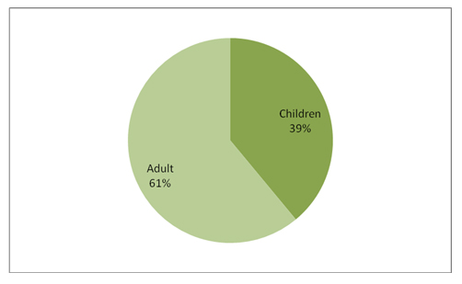
How many children are there in India?
India with 1.21 billion people constitutes as the second most populous country in the world, while children represents 39% of total population of the country.

Slide 5
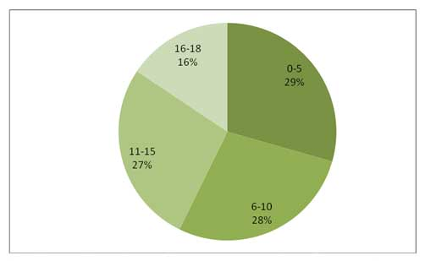
Age group of India’s Children *
The figures show that the larger number of about 29 percent constitutes Children in the age between 0-5 years.
The share of Children (0-6 years) in the total population has showed a decline of 2.8 points in 2011, compared to Census 2001.
The children's population (0-18) is 472 million.

Slide 6
Age group VS Gender of India’s Children *
While an absolute increase of 181 million in the country’s population has been recorded during the decade 2001-2011, there is a reduction of 5.05 millions in the population of children aged 0-6 years during 2010-11.
The decline in male children is 2.06 million and in female children is 2.99 millions.
The share of Children (0-6 years) in the total population has showed a decline of 2.8 points in 2011, compared to Census 2001 and the decline was sharper for female children than male children in the age group 0-6 years.

Slide 7
Age group VS Gender of India’s Children *

Slide 8
Gender of India’s Children *
The number of boys has dropped 2.42 per cent and that of girls 3.80 per cent. Population (0-6 years) 2001-2011 registered minus (-) 3.08 percent growth with minus (-)2.42 for males and -3.80 for females.
The proportion of Child Population in the age group of 0-6 years to total population is 13.1 percent while the corresponding figure in 2001 was 15.9 percent.
The decline has been to the extent of 2.8 points.

Slide 9
Gender of India’s Children *

Slide 10
Rural - Urban Distribution of Children Population *

Slide 11
State wise distribution of Children’s population *
Uttar Pradesh (19.27%) is the state with highest children’s population in the country followed by Bihar (10.55 %), Maharashtra (8.15 %), West Bengal (6.81 %) and Madhya Pradesh (6.46%) constitutes 52% of Children’s population in the country.

Slide 12
State wise distribution of Children’s population *

Slide 13
State wise and Gender wise distribution of Children’s population*

Slide 14
Male – Female Children’s Ratio * The Child gender Ratio in the country has declined

Slide 15
Gender wise Adult V/S Children *

Slide 16
Gender wise distribution of Rural - Urban Children Population *

Slide 17
Age distribution of Rural & Urban population*

Slide 18
Age distribution of Rural & Urban population*

Slide 19
Comparison of Adult and Children population in Rural and Urban India *

Slide 20
Reference
http://www.childlineindia.org.in/child-in-india.htm 4.30pm, 02/09/2018
*Data Source: Census of India 2010-11

