Slide 1
Understanding One’s Own Emotions
Mr. Vijay Sansare
Assistant Professor

Slide 2
Meaning of Emotions
Emotion is difficult to define but always consists of feelings, behaviour, physiological change and cognitions and always occurs in a particular context which influences it.
It’s major function is to give information to the individual about their interaction with the world.

Slide 3
Meaning of Emotions
people also tend to agree that the word emotion ‘strictly’ refers to a very specific kind of state.
States of that kind occur briefly and occasionally (perhaps once a day) in everyday life.

Slide 4
Meaning of Emotions
Campos et al. (1994): "emotions are those processes which establish, maintain, change, or terminate the relation between the person and the environment on matters of significance to the person”

Slide 5
Meaning of Emotions
An emotion is usually caused by a person consciously or unconsciously evaluating an event as relevant to a concern (a goal) that is important; the emotion is felt as positive when a concern is advanced and negative when a concern is impeded.
Working definition (Frijda)

Slide 6
Meaning of Emotions
An emotion is usually experienced as a distinctive type of mental state, sometimes accompanied or followed by bodily changes, expressions, actions.
Working definition (Frijda)
Emotions are intense feelings that are directed at someone or something.
David Hume

Slide 7
Primary Emotions
Love
Joy
Surprise
Anger
Sadness
Fear
Parrot (2001)

Slide 8
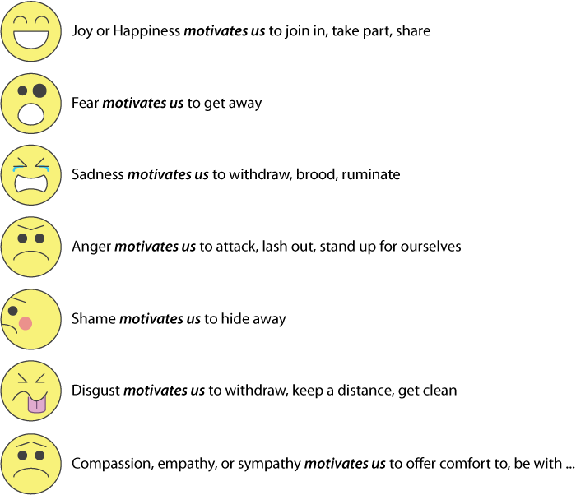

Slide 9
