Slide 1
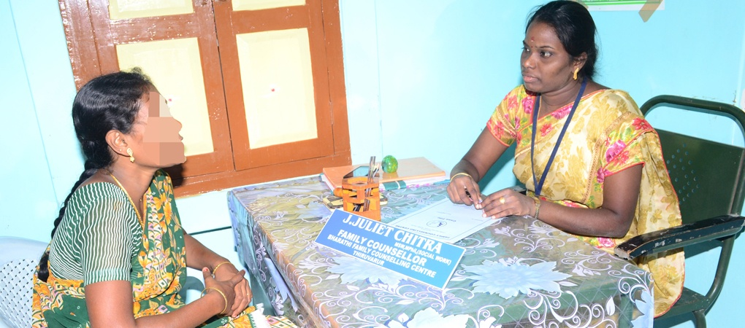
Family Counselling Centre (FCC)

Slide 2
Definition of Counselling
Counselling is an activity that takes place when someone who is troubled invites and allows another person to enter a particular kind of relationship with them.
समुपदेशन अशी एक प्रक्रीया आहे, ज्यात एखादी त्रस्त व्यक्ती दुसऱ्या व्यक्तीला आमंत्रण देते आणि विशिष्ट प्रकारे दोघांमध्ये संबंध प्रस्थापित करण्यास मोकळीक देते
John Macliodh (2007)

Slide 3
Introduction
The Central Social Welfare Board was established in 1953 by a Resolution of Govt. of India to carry out,
welfare activities for promoting voluntarism,
providing technical and financial assistance to the voluntary organisations for the general welfare of family, women and children.

Slide 4
Introduction
Under the guidance of Dr. Durgabai Deshmukh various welfare schemes were introduced by the CSWB
The Central Social Welfare Board obtained its legal status in 1969.
It was registered under section 25 of the Indian Companies Act, 1956
The State Social Welfare Boards were set up in 1954 in all States and Union Territories.

Slide 5
INTRODUCTION
Many projects and schemes have been implemented by the Central Social Welfare Board, like
Grant in Aid, Welfare Extension Projects,
Mahila Mandals , Socio Economic Programme, Dairy Scheme,
Condensed Course of Education Programme for adolescent girls and women,
Vocational Training Programme, Awareness Generation Programme,
National Creche Scheme,

Slide 6
INTRODUCTION
Many projects and schemes have been implemented by the Central Social Welfare Board,
Short Stay Home Programme,
Integrated Scheme for Women's Empowerment for North Eastern States,
Innovative Projects and Family Counselling Centre Programme

Slide 7
INTRODUCTION
The scheme of Family Counselling Centre was introduced by the CSWB in 1983.
The scheme provides counselling, referral and rehabilitative services to women and children who are the victims of atrocities, family maladjustments and social ostracism and crisis intervention and trauma counselling in case of natural/ manmade disasters.

Slide 8
INTRODUCTION
This family counselling centre focuses on misunderstanding problems, suspiciousness, unemployment, depression, love affair, extra marital affair, pre-marital problem, dowry problem etc.
The family counselling centre help the individual for an enhanced level of functioning when they are unable to cope with the problem brought in by these changes.

Slide 9
INTRODUCTION
family counselling centre aims at reducing the problems and crisis, strengthening family coping skills, effecting positive changes in the attitude, improvement in life style, providing timely counselling and support to lead a qualitative life style.

Slide 10
Objectives of FCC
Pre-marital counselling
Counselling for destitute women
Legal counselling for women in divorce cases
Counselling for marital, mal- adjustment problems.
Counselling to tackle issues like eve teasing.

Slide 11
Objectives of FCC
To create awareness about family problem, marital problem, adolescent problem, sex education etc.
To give special education to the family members with support and extra care to the client.
To encourage the family to listen supportively to the person.
To get emotional support for the family which helps greatly is facing problems.

Slide 12
Objectives of FCC
To discuss the family problem with the client very carefully and react fully with the family.
To encourage the role responsibility and need to normalise the activities of the individual and the client.
To educate both client and family members as how to handle their family problems.

Slide 13
Main Activities of the FCC
Individual counselling,
Group counselling,
Family therapy,
Behaviour modification therapy,
Environment modification therapy,
Marital therapy,
Reality therapy and
Psychological support to the client and family members

Slide 14
Financial Norms Of FCC
Honorarium for Counsellors in Category ’A’ cities FCCs and VABs fixed @ Rs. 7,000/- per month and for Counsellors of Category ‘B’ cities FCCs @ Rs. 5,500/- per month.
Financial support for non-recurring item of expenditure increased from Rs. 15,000/- to Rs. 25,000/- (one time grant).
Cost of other recurring expenditure may be increased from Rs. 40,000/- to Rs. 60,000/- per annum per FCC.

Slide 15
Financial Norms Of FCC
Provision of Rs. 2.50 crores for Training Programmes of Counsellors and office bearers of FCCs was agreed to @ Rs. 2,00,000/- for each Training Programme consisting of 30 Counsellors and 30 Office bearers.
There shall be no change in the ratio of matching share to be given by the implementing agencies in respect of other Recurring Expenditure. This will remain 80% share of GOI and 20% share of implementing agency.

Slide 16
Counselling in the family
Family integrity
Family stability
Family health
Family tress
Family discomfort
Family is good, society is good ….
Every family has a particular structure
पती – पत्नी यांच्यामधील जिव्हाळ्याचे संबंध हा कौटुंबिक समुपदेशनाचा पाया होय.

Slide 17
References
http://www.cswb.gov.in/about-cswb-0
http://www.bharathiwomen.org/family.php
http://www.wcd.nic.in/schemes/family-counselling-centre-scheme
Voluntary Action Bureau (VAB)

