Slide 1
Family Life Education
Conceptual Understanding

Slide 2
Understanding concepts
Family
Kinship
Marriage
Value system in family
Relationship and bonding in family life

Slide 3
Family
According to George Peter: 'The family is a social group characterized by common residence, economic co-operation and reproduction. It includes adults of both sexes, at least two of whom maintain a socially approved sexual relationship, and one or more children, own or adopted."

Slide 4
Marriage
Marriage is not only an event that unites two people (and their families) in a relationship with a variety of mutual obligations; it also is the event that marks the attainment of adult status

Slide 5
Family Life Cycle
Duvall (1977) discussed eight stages of family life cycle:
Married couples without children
Child bearing families- oldest child from birth to 30 months
Families with preschool children- oldest child 2.5 years to 6 years
Families with school children – oldest child 6 years to 13 years

Slide 6
Families with teenagers – oldest child 13 to 20 years
Families with launching young adults – from first to last child leaving home
Middle aged parents- empty nest to retirement
Ageing family members- retirement to death of both spouses

Slide 7
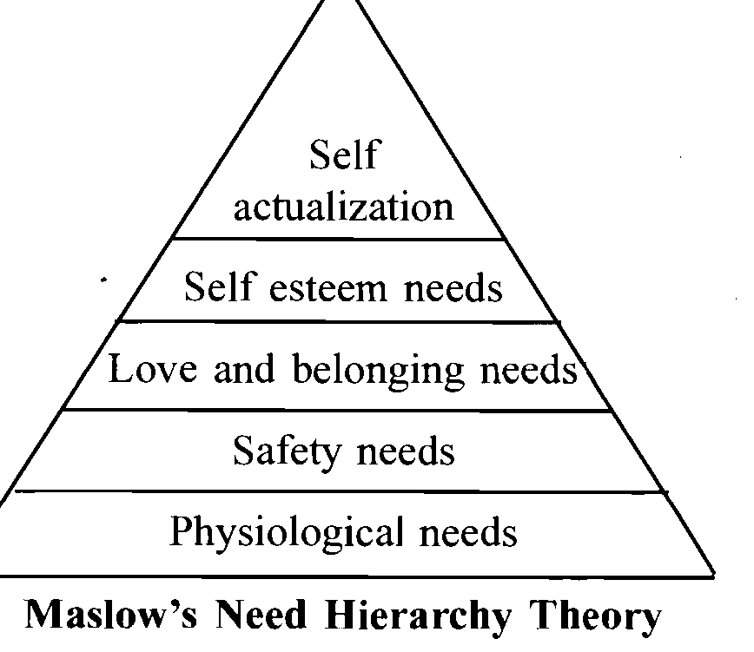
Family Resources

Slide 8
Family life education
Family Life Education is a broad and flexible field. Anything which contributes to the total growth and well being of the family - physical, mental, emotional, economic, and spiritual - can be included under the umbrella of family life education.

Slide 9
Family Life Education (FLE)
"Family life education refers to those educational concepts and experiences that influence attitudes towards family living, personal relationships and sexual development" (Department of Education, Virginia {USA), 1978)

Slide 10
Family life education includes a study of self awareness, understanding of others, of sexuality, marriage and parenthood.
The knowledge gained and skills developed will contribute to the individuals ability to cope both with social change and with relationships in society as a citizen, spouse and parent.

Slide 11
FLE focuses on healthy family functioning within a family
The skills and knowledge needed for healthy functioning are widely known: strong communication skills, knowledge of typical human development, good decision-making skills, positive self-esteem, and healthy interpersonal relationships.

Slide 12
The goal of family life education is to teach and foster the knowledge and the skills to enable individuals and families to function optimally.

Slide 13
Advantages of FLE
Family life education provides an educational role
Family life education acts as a crisis manager
Family life education provides skills for preventive action and knowledge for decision making particularly among adolescents
Family life education helps in understanding one's own role with the changing family structure and functions.
Family life education helps in proper understanding of family life cycle

Slide 14
Need of Family Life Education
Family life education is necessary for each individual
The concept of family life education refers to a variety of formal and informal efforts by which persons become ready for the roles and responsibilities of family life
Various Conflicts in the family
The activity becomes a full-time paid occupation

Slide 15
Training schools and curricula are established
Rapid technological and social changes of today's world have increased the need for individuals, families, and societies to enhance interpersonal and decision-making skills of each member of the family
Professionals working in this area and allied fields need training

Slide 16
Value Education for FLE
Value:
A value is a belief that something is good and desirable
It defines what is important, worthwhile and worth striving
Values are one's judgments
Values vary from society to society

Slide 17
Traditional Value System
Status of Women in Family
Religious values in the family
Early Marriage system in rural areas
Unplanned child birth
Child birth is considered as a blessings of the God- Preference to “Boy”
Marriage as per social status- prohibition on Inter-caste marriage
Misconception regarding Sex Education

Slide 18
Importance of different types of value
Moral or Ethical Values
Cultural Values
Religious Values
Personal Values

Slide 19
Value Education:
Chilana (1987) studied Indian culture and observed that Indian culture is based on the values, viz, kind heartedness, self control, universal brotherhood, honesty, respect to others and faith.
Due to deterioration of these values, new values like indiscipline and destructive mentality came into existence.
He suggested to include these values in curriculum and called it value-based curriculum.

Slide 20
Understanding Value Edu…
“When human values are inculcated through curriculum to transcend to cognitive, affective and psychomotor level for conducive development of individual, society, national and international understanding, it is called value education”
“Value education claims a vast field for its coverage to mould the behaviour and transform the right ways of action in day-to-day life activities”

Slide 21
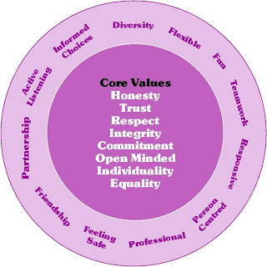

Slide 22
Cntd..
Type of Value | Areas of Values
Human Value: Truthfulness , Sacrifice, Sincerity , Self control | Human Behaviour
National or Constitutional values | Constitutional Rules
Social Values: Pity and probity, self control, universal brotherhood, respect and faith. | Rules about the Society
Vocational values: Knowledge thirst, sincerity in profession, regularity, punctuality and faith. | Ideals in various profession
Religious Values: | Ideals related to religion
Aesthetics values: | Value in Arts and Literature

Slide 23
Married couple & FLE
Two individuals from separate families of origin unite to form a new family system
rearrangement with extended families and friends
Changing roles of spouse
Marriage of partners from divergent cultural backgrounds
Increasing physical distances between family members

Slide 24
Child bearing families
Become caregivers to the younger generation
Requires a commitment of time as a parent
Understanding the roles of parents
Adapting to developmental changes in children
Parental role are struggles with each other about taking responsibility
Refusal or inability to function as competent parents to children

Slide 25
The Family with Adolescents
Autonomy and seek to develop their own identity
Parents tend to adopt one of two strategies to handle noncompliance-
They either clamp down or put more pressure on the adolescent to conform to parental values
They become more liberal and let the adolescent have extensive freedom

Slide 26
Mid-Life Families
It is a time of launching children,
Playing an important role in linking generations, and
Adapting to mid-life changes in development.

Slide 27
The Family in Later Life
Retirement alters a couple’s life-style, requiring adaptation.
Grand-parenting also characterizes many families in this stage

Slide 28
Human development stages and fle
Approximate Age | Virtues | Psycho Social Crisis
0–2 years | Hopes | Basic Trust vs. Mistrust
2–4 years | Will | Autonomy vs. Shame and Doubt
4–5 years | Purpose | Initiative vs. Guilt
5–12 years | Competence | Industry vs. Inferiority
13–19 years | Fidelity (Loyalty to a person) | Identity vs. Role Confusion
20–24 years | Love | Intimacy vs. Isolation
25–64 years | Care | Generativity vs. Stagnation
65-death | Wisdom | Ego Integrity vs. Despair

Slide 29
Hopes: Trust vs. Mistrust
If the parents expose the child to warmth, regularity, and dependable affection, the infant's view of the world will be one of trust.
If the parents fail to provide a secure environment and to meet the child's basic needs a sense of mistrust will result.
Development of mistrust can lead to feelings of frustration, suspicion, withdrawal, and a lack of confidence.

Slide 30
Caregivers are consistent sources of food, comfort, and affection, an infant learns trust- that others are dependable and reliable.
If they are neglectful, or perhaps even abusive, the infant instead learns mistrust- that the world is in an undependable, unpredictable, and possibly a dangerous place.
While negative, having some experience with mistrust allows the infant to gain an understanding of what constitutes dangerous situations later in life.

Slide 31
Will: Autonomy vs. Shame & Doubt
Child gains control over eliminative functions and motor abilities they begin to explore their surroundings
The parents' patience and encouragement helps foster autonomy in the child
Children at this age like to explore the world around them and they are constantly learning about their environment.
Caution must be taken at this age while children may explore things that are dangerous to their health and safety

Slide 32
Caregivers encourage self-sufficient behaviour, —a sense of being able to handle many problems on their own.
But if caregivers demand too much too soon, refuse to let children perform tasks of which they are capable, children may instead develop shame and doubt about their ability to handle problems

Slide 33
Purpose: Initiative vs. Guilt
At this stage, the child wants to begin and complete their own actions for a purpose.
Guilt is a confusing new emotion.
They may feel guilty over things that logically should not cause guilt.
They may feel guilt when this initiative does not produce desired results.

Slide 34
Competence: Industry vs. Inferiority
Children at this age are becoming more aware of themselves as individuals.
They work hard at "being responsible, being good and doing it right.
They are now more reasonable to share and cooperate
Children start recognizing their special talents and continue to discover interests as their education improves
If not allowed to discover own talents in their own time, they will develop a sense of lack of motivation, low self-esteem, and lethargy

Slide 35
Fidelity: Identity vs. Role Confusion
The transition from childhood to adulthood
Identity crisis
Role confusion

Slide 36
Love: Intimacy vs. Isolation
Once people have established their identities, they are ready to make long-term commitments to others.
They become capable of forming intimate, reciprocal relationships (e.g. through close friendships or marriage) and willingly make the sacrifices and compromises that such relationships require.
If people cannot form these intimate relationships – perhaps because of their own needs – a sense of isolation may result.

Slide 37
Care: Generativity vs. Stagnation
During middle age the primary developmental task is one of contributing to society and helping to guide future generations.
A sense of productivity and accomplishment- results.
In contrast, a person who is self-centered and unable or unwilling to help society move forward develops a feeling of stagnation- a dissatisfaction with the relative lack of productivity.

Slide 38
Wisdom: Ego Integrity vs. Despair
The final developmental task is retrospection: people look back on their lives and accomplishments.
They develop feelings of contentment and integrity if they believe that they have led a happy, productive life.
They may instead develop a sense of despair if they look back on a life of disappointments and unachieved goals

