Slide 1
Semester II:
GC - Generic Compulsory Method Course
G VIII
Social Work Research & Statistical Applications
Dr. Jaimon Varghese

Slide 2
G VIII
Social Work Research & Statistical Applications
UNIT – 1: Fundamentals of scientific methods and research
UNIT - 2: Research design, Sources of data
UNIT – 3: Data collection and processing
UNIT – 4: Statistics for research, techniques and its application
UNIT – 5: Presentation and Dissemination of research

Slide 3
Unit 3:
Data collection and processing
1. Tools of data collection: Primary and secondary tools
2. Processing of data: Content, editing data, classification, coding, tabulation; interpretation and analysis of data, diagrammatic and graphical presentation of data.
3 Scales: Need, importance, types and application of scales.
4 Application of computers: Data processing, analysis, Excel and SPSS.

Slide 4
Tools for data collection
  Primary tools for Collection of primary data
    Questionnaire
    Interview (structured & unstructured) schedule
    Observation guide
    Focussed group discussion guide
    Case study
    Tests

Slide 5
Tools for data collection
  Secondary Tools for collection of secondary data (content analysis)
    Periodical review
    Official records and reports
    Literature (research) reviews
    Web resources
    Books & journal reviews

Slide 6
Unit 3:
Data collection and processing
2. Processing of data:
Content
editing data,
classification,
coding,
tabulation;
interpretation and analysis of data,
diagrammatic and graphical presentation of data.

Slide 7
Unit 3:
Data collection and processing
1. Content
Content (development) – list of content; chapter plan
Chapter plan
  Introduction
  Research methodology & review of studies
  Data based chapters (3-5)
  Conclusion (summary of findings, testing of hypothesis and suggestions)

Slide 8
2. Editing of Data
    Missing entries
    Illegible entries
    Discrepancies

Slide 9
3. Classification
Data can be classified as either primary or secondary
Primary data mean original data that have been collected through primary means and the secondary data is collected through secondary sources
Classification of the data may be done on the basis of the objectives of the study, so that the bits of data collected through various methods may be combined chapterwise before the statistical analysis

Slide 10
4. Coding
Coding of data involves assigning of number to each response of the question.
The purpose of giving number to each response is to translate raw data into numerical data, which may be counted and tabulated.

Slide 11
Coding Continues…..
The coding scheme will vary according to the types of questions :
    open end,
    close end,
    matrix,
    factual,
    opinion,

Slide 12
Interview Schedule
Q. 34. Are you married? Yes/ No, If yes, how many children do you have?
Coding:
Q.34: Yes = 1
        No = 2
Q.34 (a): (Write the actual number )One = 1
          Two = 2
          More than two = 3

Slide 13
CODE BOOK
CODE BOOK
Q .No. | Variable No. | Variable | Categories | Code
2 | V1 | Age | Actual | -
3 | V2 | Designation | Worker Supervisor Manager | 1 2 3
4 | V3 | Establishment | Public Private | 1 2
5 | V4 | Level of Education | Graduate Intermediate High School Middle School Primary Illiterate Other | 1 2 3 4 5 6 7
6 | V5 | Marital Status | Married Unmarried Widow Divorce | 1 2 3 4
43 | V42 | Attitude of Employer Preference for male employees | Agree Undecided Disagree | 1 2 3

Slide 14
Preparing a Master Chart
After a codebook is prepared, the data can be transferred either to a master chart or directly to computer through a statistical package

Slide 15
Master Chart Continues……
Entering data directly to computer is disadvantageous, as there is no way to check wrong entries, which will show inconsistencies in tabulated data at the later stages of tabulation.
Going through master chart to computer is much more advantageous than entering data directly to computers.

Slide 16
MASTER CHART
 |  | VARIABLE LABELS
 | RESPONDENT NUMBER | AGE | DESIGNATION |  | ESTABLISHMENT | LEVEL OF EDUCATION | MARITAL STATUS | NATURE OF WORK | DURATION OF WORK |  | WAGES | PROMOTIONS | ATTITUDE OF EMPLOYER
 |  | VARIABLE NUMBER
 |  | V1 |  | V2 | V3 | V4 | V5 | V6 |  | V7 | V8 | V9 | V10
 | 1 | 23 |  | 3 | 4 | 2 | 2 | 3 |  | 14 | 1220 | 3 | 4
 | 2 | 28 |  | 2 | 3 | 4 | 1 | 5 |  | 5 | 1547 | 3 | 3
 | 3 | 23 |  | 4 | 4 | 4 | 2 | 1 |  | 4 | 1922 | 1 | 3
 | 4 | 28 |  | 1 | 3 | 3 | 1 | 2 |  | 5 | 1847 | 2 | 5
 | 5 | 23 |  | 3 | 4 | 2 | 2 | 1 |  | 7 | 2922 | 1 | 1

Slide 17
5. Tabulation plan
Decide how many tables
  Uni-variate / bi-variate / tri-variate / multi variate
Charts from the table and as a substitute for table
Organise tables and charts chapter wise

Slide 18
Univariate, bi-variate, tri-variate and multivariate analyses of data
Uni-variate analysis refers to tables, which gives data relating to one variable.
Uni-variate tables which are more commonly known as frequency distribution tables show how frequently an item repeats.
Bi-variate, tri-variate and multi-variate analyses presents two, three or more variables with the scope of comparison and correlational analysis

Slide 19
UNIVARIATE DATA ANALYSIS……
TABLE 4.3: RELIGION OF RESPONDENTS
Religion | Distribution of Respondents
 | Frequencies | Percentages
Hindus | 190 | 66.67
Muslims | 77 | 27.01
Christians | 18 | 6.32
Total | 285 | 100.00

Slide 20
UNIVARIATE DATA ANALYSIS……
The characteristics of the sample while examining the percentages, further properties of a distribution can be found out by various measures of central tendencies.
A frequency distribution of a single variable is the frequency of observation in each category of a variable.

Slide 21
UNIVARIATE DATA ANALYSIS……
To analyse the data it is necessary to convert the frequencies into figures that can be interpreted meaningfully.
Frequencies expressed in comparable numbers are called proportions or percentages.

Slide 22
UNIVARIATE DATA ANALYSIS……
For example, the proportion (p) of the ‘Hindus’ in Table 4.3 may be ascertained as follows :
p = 190 / 285
= .6667
Proportions when multiplied by 100 become percentage (P).
P = .6667x100=66.67 per cent.

Slide 23
UNIVARIATE DATA ANALYSIS……
Proportions and percentages permit the comparison of two or more frequency distributions .
An examination of the pattern of response to variable ‘Religion ‘ in Table 4.3 would provide a description of the number of respondents who are ‘Hindus’, ‘Muslims’, and ‘Christians’.

Slide 24
UNIVARIATE DATA ANALYSIS……
It is evident that majority of the respondents (66.67 per cent) are Hindus.
Almost two-third of the respondents are Hindus.

Slide 25
BIVARIATE DATA ANALYSIS AND INTERPRETATION: APPLICATION OF INFERENTIAL STATISTICS
  ►ASSOCIATION BETWEEN TWO VARIABLES
  ☻Bivariate Analysis Inferences

Slide 26
CONVENTIONS
Usually, the independent variable is the row variable and the dependent variable is the column variable.
  Independent Variable : Gender
  Dependent Variable : Life Satisfaction

Slide 27
BIVARIATE TABLE
TABLE 4.8
GENDER AND LIFE SATISFACTION
Gender | Life Satisfaction |  |  | TOTAL
 | High | Moderate | Low
Men | 30 | 70 | 100 | 200
Women | 65 | 90 | 45 | 200
Total | 95 | 160 | 145 | 400

Slide 28
INTERPRETATION …..
Gender divided into men and women.
Each gender grouping is described in terms of “High”, “Moderate” and “Low” life satisfaction.
Men and women are compared in terms of life satisfaction.

Slide 29
PERCENTAGING IN BIVARIATE TABLES
Row Percentage
Row Total (100) is base for calculating percentage.
Column Percentage
Column Total (100) is base for calculating percentage.

Slide 30
ROW PERCENTAGE
TABLE 4.8
GENDER AND LIFE SATISFACTION
Gender | Life Satisfaction |  |  | TOTAL
 | High | Medium | Low
Men | 30(15.0) | 70 (35.0) | 100 (50.0) | 200 (100.0)
Women | 65 (32.5) | 90 (45.0) | 45 (22.5) | 200 (100.0)
Total | 95 | 160 | 145 | 400

Slide 31
Trivariate Analysis
TABLE 4.8
GENDER AND LIFE SATISFACTION
Gender | Life Satisfaction |  |  | TOTAL
 | High | Medium | Low
Men Youth Old | 18 12 | 40 30 | 60 40 | 200 (100.0)
Women Youth Old | 35 30 | 50 40 | 25 20 | 200 (100.0)
Total | 95 | 160 | 145 | 400

Slide 32
INFERENCE …..
Men with High Life Satisfaction = 30 (15%)
Men with Low Life Satisfaction = 100 (50%)
Women with High Life Satisfaction = 65 (32.5%)
Women with Low Life Satisfaction = 45 (22.5%)
Inference
Women are more satisfied
with life than men.

Slide 33
Interpretation & analysis of data
Each table has to be analyzed and interpreted
Give an introductory paragraph for each table:
  Relevance of question asked
  Introduction of the response categories
Below the table, mention the major findings with mean, standard deviations, proportions etc.
Compare the findings within the table
Compare the findings between the tables (correlations)
Rationalise / justify the major findings

Slide 34
Diagrammatic and graphical presentation of data
Diagrams and graphs are often substitutes for tables (not additions)
Pie diagram
Bar diagram
Line graph
Histogram
Smart art

Slide 35
Unit 3: Data collection and processing
3 Scales: Need, importance, types and application of scales
Scaling of behavioural characteristics such as attitudes and interests in psychological dimension
Need
  Assessment of psychological characteristics
Importance
  Quantification of qualitative data
Types
    Likert’s summative scale (unidimensional)
    Thurstone’s equally appearing interval
    Guttman’s cumulative scaling or scalogram analysis

Slide 36
Likert’s Summative Scale
1. Most of the people in the world are religious. (1) Strongly Agree (2) Agree (3) Indifferent (4) Disagree (5) Strongly Disagree
2. Are you a religious person (1) Strongly Agree (2) Agree (3) Indifferent (4) Disagree (5) Strongly Disagree
3. Religion is very useful institution. (1) Strongly Agree (2) Agree (3) Indifferent (4) Disagree (5) Strongly Disagree
4. Religion offers relief to human suffering. (1) Strongly Agree (2) Agree (3) Indifferent (4) Disagree (5) Strongly Disagree
5. Most of the people in the world are spiritual. (1) Strongly Agree (2) Agree (3) Indifferent (4) Disagree (5) Strongly Disagree
6. Are you a spiritual person? (1) Strongly Agree (2) Agree (3) Indifferent (4) Disagree (5) Strongly Disagree
Summated score 30 MEANS LEAST RELIGIOUS & SPIRITUAL
Summated score 6 MEANS HIGHLY RELIGIOUS & SPIRITUAL

Slide 37
Thurstone’s Equally Appearing Interval
There are 5 positions between authoritarian personality and submissive personality
You are given 5 statements each having 1 – 5 points scoring
You have to indicate your agreement on any one of the statement
Your position will be that of the statement
  I give only orders and never listen to anyone
  I often give orders, sometimes obey others
  I give orders 50 % of the time and listen to others 50%
  I seldom give orders and mostly obey others
  I never give orders and only listen to others

Slide 38
Guttman’s Scalogram
Guttman’s cumulative scaling or scalogram analysis: items presented in a cumulative degree of the characteristics; the point where the respondent expresses his difference (in agreement or disagreement) is significant

Slide 39
Guttman’s scalogram - sample
He is from Australia and is my good friend, I talk with him everyday via. Facebook
He is from Australia and is my good friend, I talk with him everyday via. Facebook. I wish to see him in my country
He is from Australia and is my good friend, I talk with him everyday via. Facebook. I wish to take him my home
He is from Australia and is my good friend, I talk with him everyday via. Facebook. I wish to give him accommodation and cook for him
He is from Australia and is my good friend, I talk with him everyday via. Facebook. I wish I could live with him (marry him)

Slide 40
Unit 3:
Data collection and processing
Application of scales
  Generally psychological scales are not used in social work research
  Scales may be used in social work research in the field of medical and psychiatry, family and child welfare, hospital social work, school social work, correctional social work and industrial social work
  Scales are used as supplementary tools for questionnaire and interview schedules to validate the psychosocial information collected
  Standardised scales should be used. Caution should be taken to customise a standardised scale according to the situation. An item may be replaced with a similar item so that the reliability and validity of the scale will not be affected

Slide 41
Unit 3:
Data collection and processing
4 Application of computers: Data processing, analysis, Excel and SPSS
Use of Excel
  Sampling (generation of random numbers)
  Master chart (spread sheet)
  Tabulation (one / two / three / multiple way)
  Graphical and diagrammatic presentation
  Statistical calculations (use of formula)

Slide 42
Unit 9: INTRODUCTION TO STATISTICAL
PACKAGE FOR
SOCIAL SCIENCES
(SPSS)

Slide 43
Statistical Package for Social Sciences (SPSS)
introduction
basic steps,
  defining data (variable entry),
  data entry (numerical view / label view),
  data transformation (from excel to SPSS),
  data analysis (tabulation),
  graphical (diagrammatic) presentation,
  statistical application using SPSS (correlation analysis and tests of significance)

Slide 44
INTRODUCTION TO SPSS
SPSS- Statistical Package for Social Sciences- provides a powerful statistical analysis and data management system in a graphical environment.
SPSS uses descriptive menus and simple dialog boxes to do most of the work for you.

Slide 45
SOME SPECIAL FEATURES
Most user’s friendly Statistical Package.
Most of the tasks can be accomplished simply by pointing and clicking the mouse.
Most comprehensive package available today.
A to Z of data processing and statistical analysis.

Slide 46
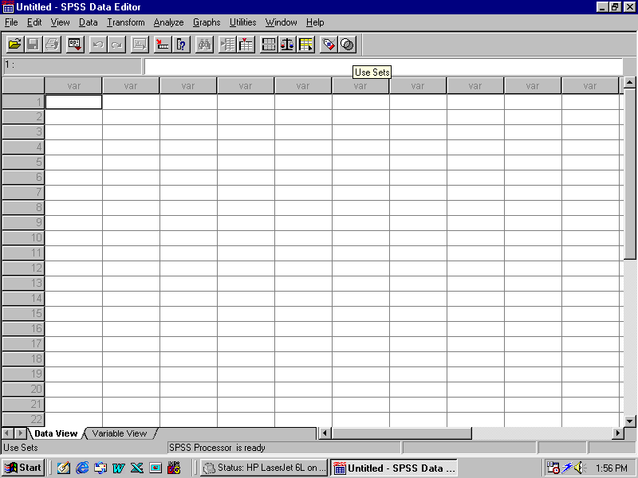
Starting the SPSS
Click the Start button and select ‘SPSS’ from program menu or double click the icon of SPSS When you start a SPSS session, the Data Editor opens automatically.
The Data Editor provides a spreadsheet for entering and editing data and creating data files.

Slide 47
BASIC STEPS IN SPSS
Step I : Define your data.
Step II : Get your data entered into SPSS Data Editor.
Step III : Select the variables for the analysis.
Step IV : Select a procedure from the menus to calculate Statistics.
Step V : Run the procedure and look at the results.

Slide 48
GETTING HELP
Every SPSS window has a HELP menu on the menu bar.
To Use the SPSS Help Table of Contents
From the menu bar in SPSS window choose :
Help
Topics
Click the Content tab
Double click on items with a book icon to expand or collapse the contents

Slide 49
TO GET HELP FOR DIALOG BOX
Click the right mouse button on the dialog box control you want to know about.
Choose What’s This ? From the pop-up menu.
A description of the control and how to use it is displayed.

Slide 50
Finding Out More about SPSS
For a comprehensive overview of SPSS basics see the online TUTORIAL.
From SPSS menu bar choose :
Help
Tutorial

Slide 51
STATISTICS COACH
If you are unfamiliar with SPSS or with Statistical procedures available in SPSS , the STATISTICS COACH can help you get started by prompting you with simple questions , non-technical language , and visual examples that help you select the basic statistical feature that are best suited to your data.
To use the Statistics Coach from the menu choose :
Help
Statistics Coach

Slide 52
DATA EDITOR
Rows represent cases.
Each respondent is a case.
First column represents case numbers.
Columns represent variables.
Each question is a variable (sometimes it may represent more than one variable)
Cells represent values/codes.

Slide 53
SPSS Data Editor

Slide 54
Important features of the Data Editor
First column represents Respondent Numbers(1, 2, 3, …..by default).
First row represents Variable Numbers (var- by default).
At the bottom left corner there are two buttons :
Data View
Variable View
Data View shows the data file and Variable View shows details about variables.
Data View
Variable View

Slide 55
Data Editor
Untitled-SPSS Data Editor displays a window with a prompt :
What would you like to do ?
○ Run the Tutorial
○ Type in Data
○ Open an existing file
More Files
○ Open another type of file
If you like to enter data select ○Type in Data, click O K button.

Slide 56
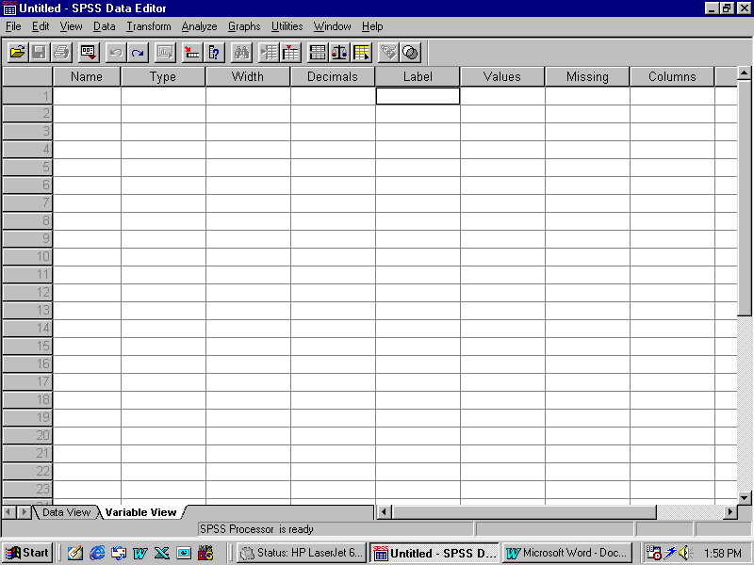
DATA DEFINING
Define Variable
Once you prepare your Code Book , you need to include it in the program for further action to be taken.
The process of including the code book is known as “Define Variable”.
To define variable click at Variable View (see the figure)
In the left bottom corner of the Data Editor there are two buttons:
Data View
Variable View

Slide 57
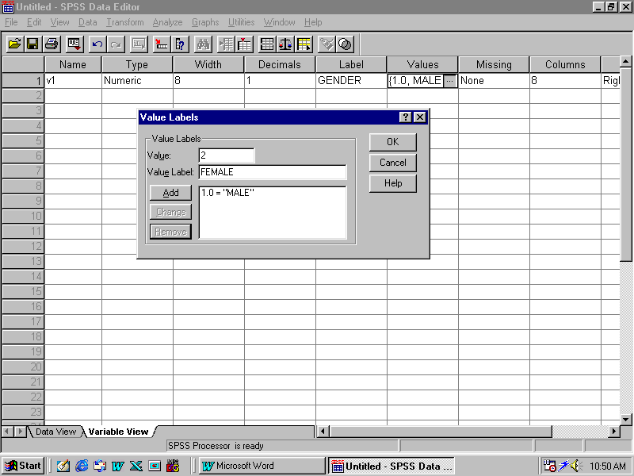
DATA DEFINING CONTINUES
Next, Click in the first column and type variable name, Label & Values
Enter the name you wish to use for the cell. In the example we have chosen the name 'V1' to stand for Gender. Next, Click on the label cell then type "Gender" in the variable label cell. Then click on the Values cell, a dialog box will appear, in that type value & value label and then click on Add button.

Slide 58
DATA EDITOR VARIABLE VIEW
 | Name | Type | Decimal | Width | Label | Values
1 | V1 |  |  |  | Age
2 | V2 |  |  |  | Gender

Slide 59
Dialog Box : Value Label
Value
1
Value Label
Male
Add
1.00 = “Male”

Slide 60
DATA DEFINING CONTINUES….
For example, type “1” in the value box, then click the value label box and type “Male” and finally click the “Add” button. Repeat for the other value of the variable. Once you have finished assigning value labels, click on continue button.
In case you need to change the labels you can always return to this dialog box. The change button can be used to change a value label.
The remove button can be used to remove a value label.
The cancel button can be used to cancel your labeling work and help button can be used to access the SPSS on line help

Slide 61
DATA EDITOR VARIABLE VIEW CONTINUES….

Slide 62
Entering Data
To enter data click on Data View .
Select a cell in the Data Editor
Enter the data value. The value is displayed in the cell of the Data Editor
Press and select another cell to enter data value.

Slide 63
Entering Data
Continues….
To enter the data, simply move the cursor to the upper-left-hand corner and enter 1 for the first respondent’s gender “male” , then Press and move the cursor one cell to the right to enter data value, say, enter 1 for the level of education “illiterate”, and so on. On the screen you will see like………

Slide 64
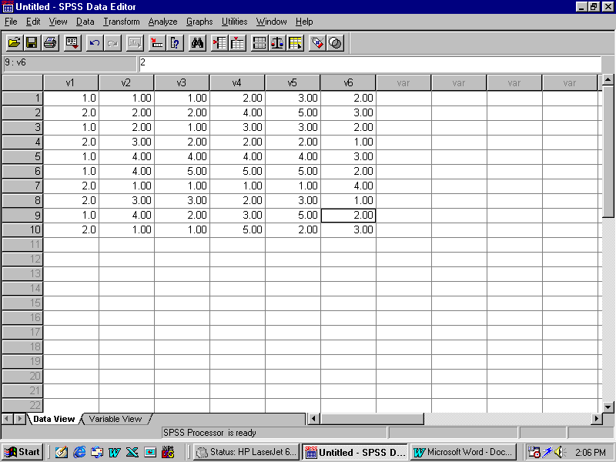

Slide 65
Saving Data and Creating a SPSS File
To save data,
From the menus choose:
File
Save
Because these data have not been saved previously, you will see a dialogue box prompting you to enter a file name. Type in the name, say, “attitude” and click the OK button. SPSS will then save the data to the file : attitude.sav. (SPSS will automatically attach the .sav extension if you do not type it in.)

Slide 66
Taking Print Out
To take print out :
From menu, choose
File
Print
Tally the data values in print out with your Master Chart.

Slide 67
Data Editing
Go to the Cell representing Respondent Number and the variable.
For example :
►Fourth respondent is male (1) but you
have entered Female (2).
►Go to the cell and now enter 1 , the data value will be corrected.
►Make all other corrections. Save the corrections.

Slide 68
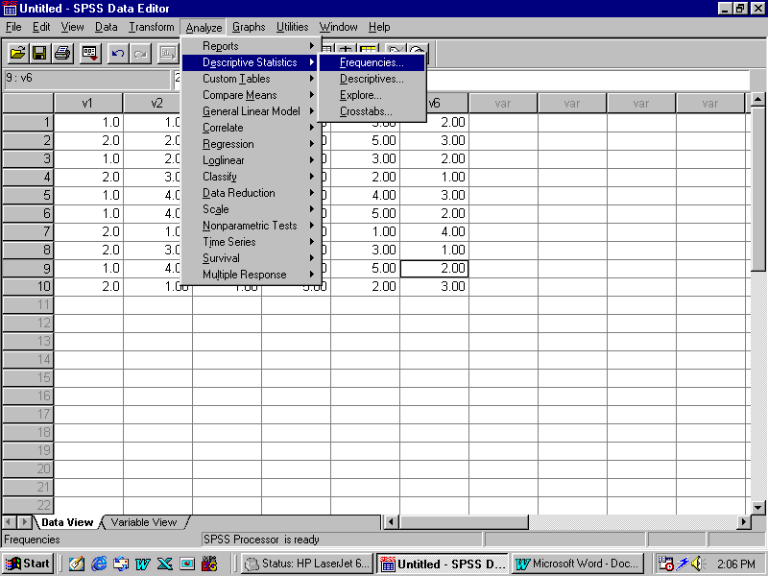
FREQUENCY TABLES
Now you are ready to analyse data with SPSS
To analyse the data:
From menu, choose
Analyse
Descriptive Statistics Frequencies

Slide 69
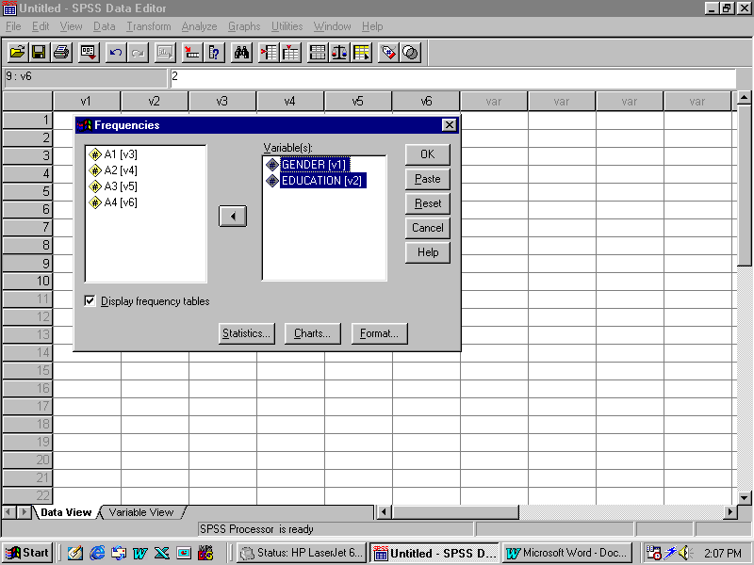
FREQUENCY TABLES Continues……….
Click the button with the picture of the right arrow. This will move list of selected variables on the right ( see the figure) Select one or more variables: To do this click the variable “V1” to select it for analysis.

Slide 70
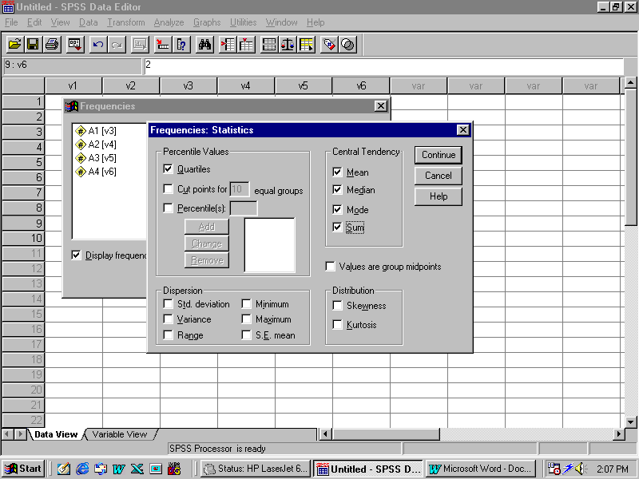
FREQUENCY TABLES Continues……….
Click Statistics for descriptive statistics for quantitative variables.
Click chart for bar chart, pie-charts and histogram.
If you click statistics you will get a dialog box .

Slide 71
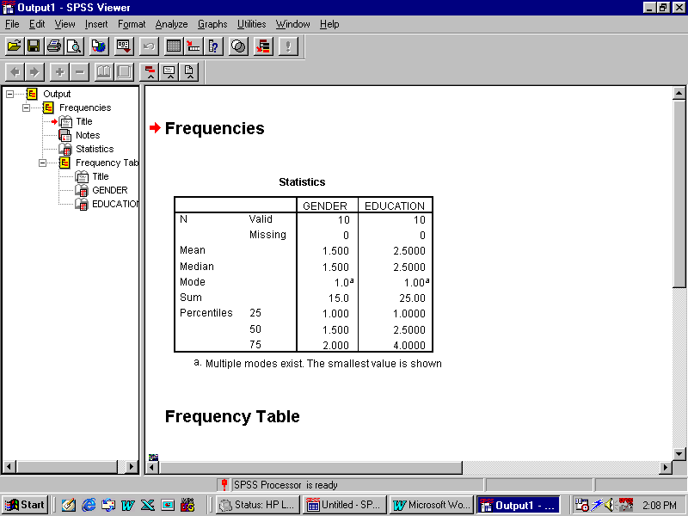
FREQUENCY TABLES Continues……….
Now click the boxes for statistics you wish to apply for your data like, mean, standard deviation, etc. Then click the ‘Continue’ button.
Now click the OK button, it automatically opens a Output – SPSS Viewer Window showing the Frequencies Tables.
Sample Output

Slide 72
Graphs /Charts
Bar Charts allow you to make selections that determine the type of chart you obtain.
Select the icon for the chart type you want, and select the option under Data in Chart that best describes your data.

Slide 73
CROSSTABLES
From menu, choose :
Analyse
Descriptive Statistics Frequencies
Descriptives
Crosstab
Click Crosstab.

Slide 74
CROSSTABLES…….
You get Crosstab Dialog Box
Highlight the variable( say ‘age’) and transfer it to the ROW Box.
Highlight another variable( say ‘opinion’) and transfer it to the COLUMN Box.

Slide 75
CROSSTABLES…….
Click button.
      Chi-square Correlations
      Lambda Gamma
Select Statistics from the Dialog Box .
Click Continue.
Statistics
√
√
√
√
√

Slide 76
CROSSTABLES…….
Click button.
      Observed Row
      Expected Column
Select Statistics from the Dialog Box .
Click Continue.
Click OK.
Cells
√
√
√
√
√

Slide 77
APPLICATION OF DESCRIPTIVE STATISTICS : UNIVARIATE DATA ANALYSIS
  ☻Univariate Analysis
  Description
  To describe profile and Independent
  Variables
  ☻Descriptive Statistics
  Proportion, percentages, ratio, mean, mode, median, standard deviation

Slide 78
Using SPSS….
To Obtain Chi-square
From the menus choose:
Analyze
Descriptive
Cross tab
Select variables for Row.
Select variables for Column
In the Frequencies dialog box, click Statistics.
Select Chi-square
Click OK in the main dialog box to run the procedure.

Slide 79
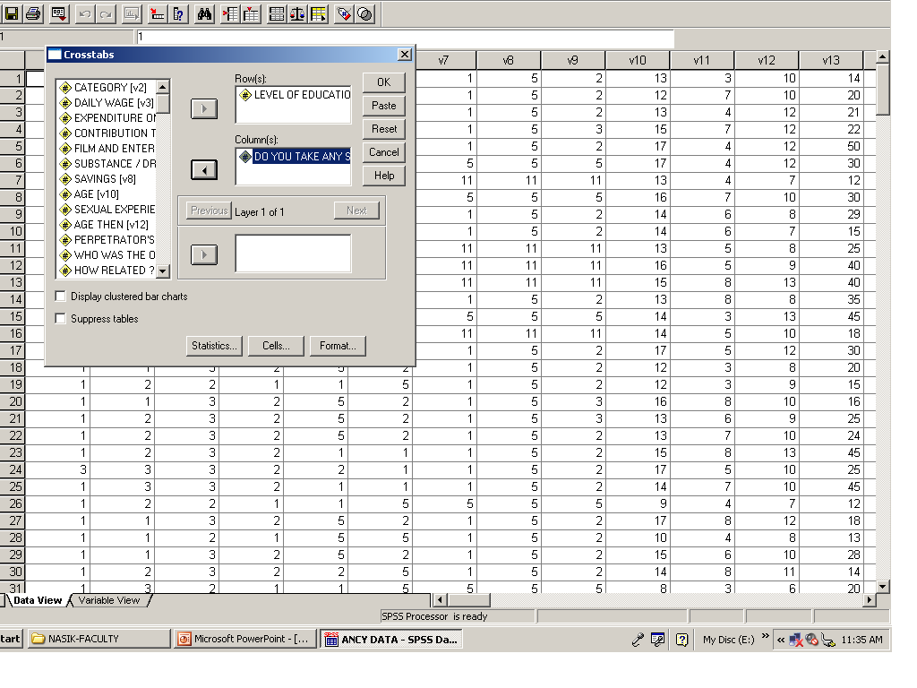
Chi-square Test

Slide 80
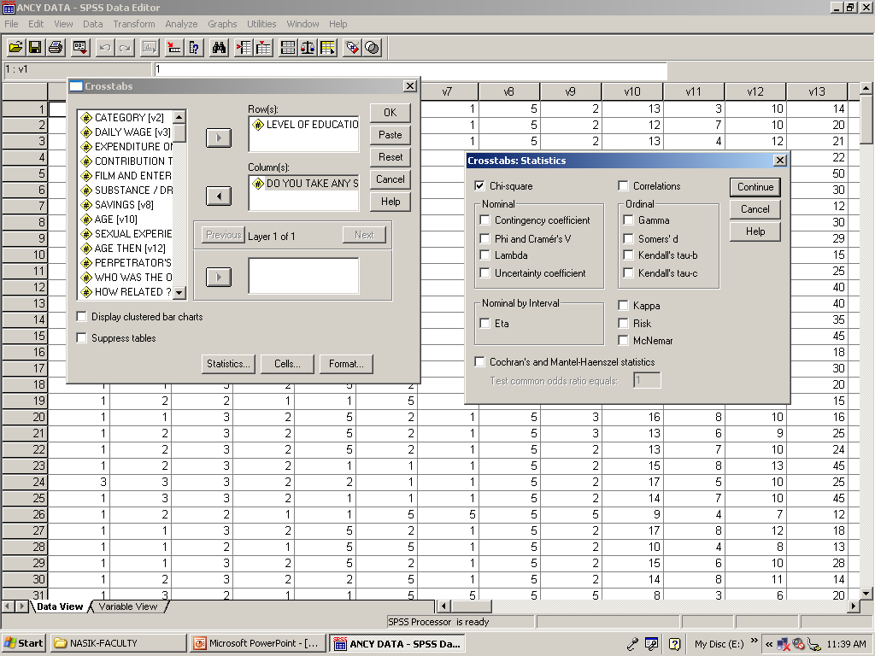
Chi-square Test

Slide 81
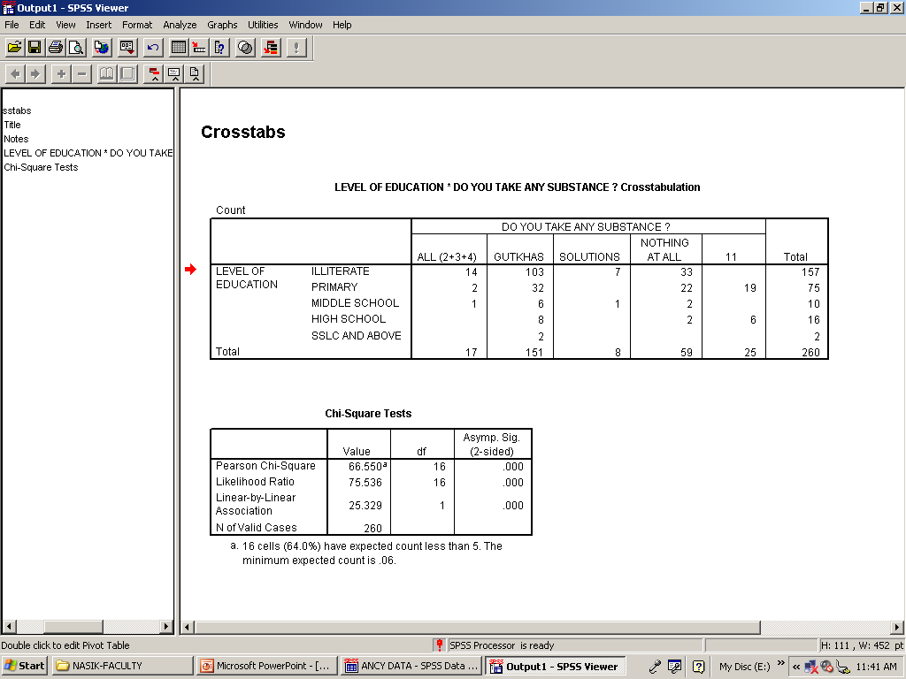
Chi-square Test

Slide 82
Paired-Samples T Test
Using SPSS…
To Obtain a Paired-Samples T-Test
From the menus choose:
Analyze
Compare Means
Paired-Samples T-Test...

Slide 83
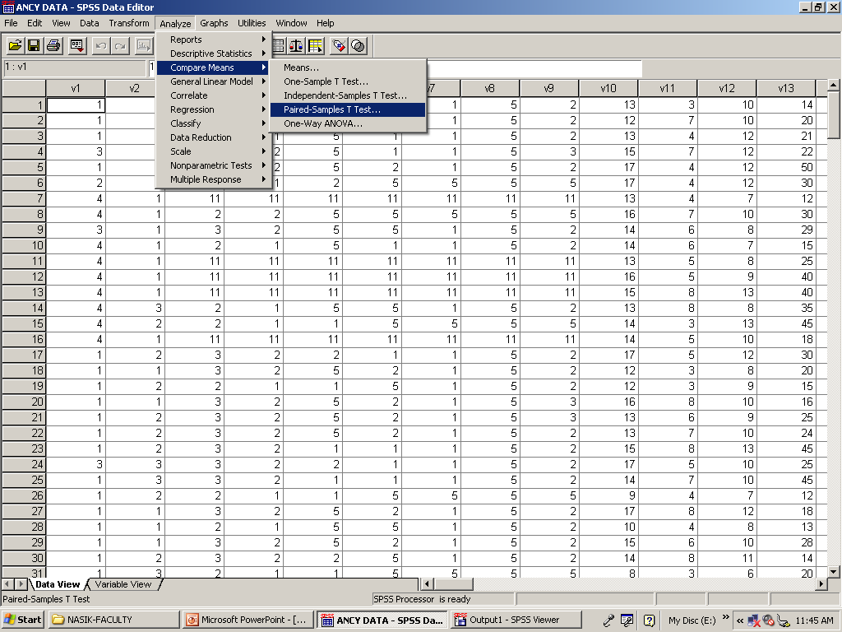
T-test Paired Sample

Slide 84
Paired-Samples T Test
Using SPSS…
Select a pair of variables:
Click each of two variables. The first variable appears in the Current Selections group as Variable 1, and the second appears as Variable 2.

Slide 85
Paired-Samples T Test
Using SPSS…
After you have selected a pair of variables, click the arrow button to move the pair into the Paired Variables list. You may select more pairs of variables.
Click OK in the main dialog box to run the procedure.

Slide 86
Independent-Samples T Test Using SPSS
To Obtain an Independent-Samples T Test
From the menus choose:
Analyze
Compare Means
Independent-Samples T Test...

Slide 87
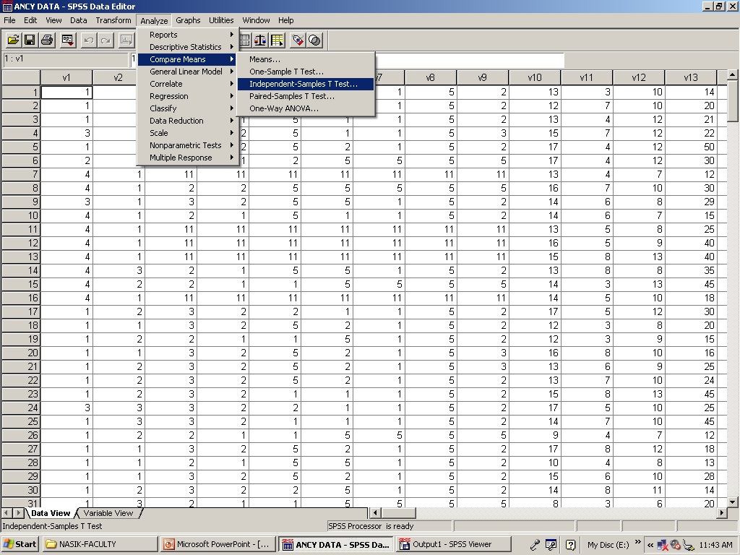
T-test Independent Samples

Slide 88
Reference
Ivan Diamonds and Juliet Jefferies (2001) Beginning Statistics – An Introduction to Social Scientists, London: Sage Publications
Dr DK Laldas (2008) Practice of Social Research at Research Methodology Workshop at CSRD-ISWR, Ahmednagar on 23-26, July, 2008.
Dr DK Laldas (2000) Practice of Social Research: Social Work Perspective, Jaipur: Rawat Publications
Dr DK Laldas (2005) Designs of Social Research, Jaipur : Rawat Publications

Slide 89
Thank You

