Slide 1
Genetic Disorders
Mr. Vijay Sansare
Assistant Professor

Slide 2
What is a gene?
A gene is a small piece of hereditary material called DNA that controls some aspect of person’s physical makeup or a process in the body. Genes comes in pairs.

Slide 3
What are chromosomes?
Chromosomes are the structures inside cells that carry genes.
Chromosomes also come in pairs. Most cells have 23 pairs of chromosomes for a total of 46 chromosomes.
Sperm and egg cells each have 23 chromosomes. During fertilization when the egg and sperm join, the two sets of chromosomes come together.
In this way, one half of a baby’s genes come from the baby’s mother and one half come from the baby's father

Slide 4
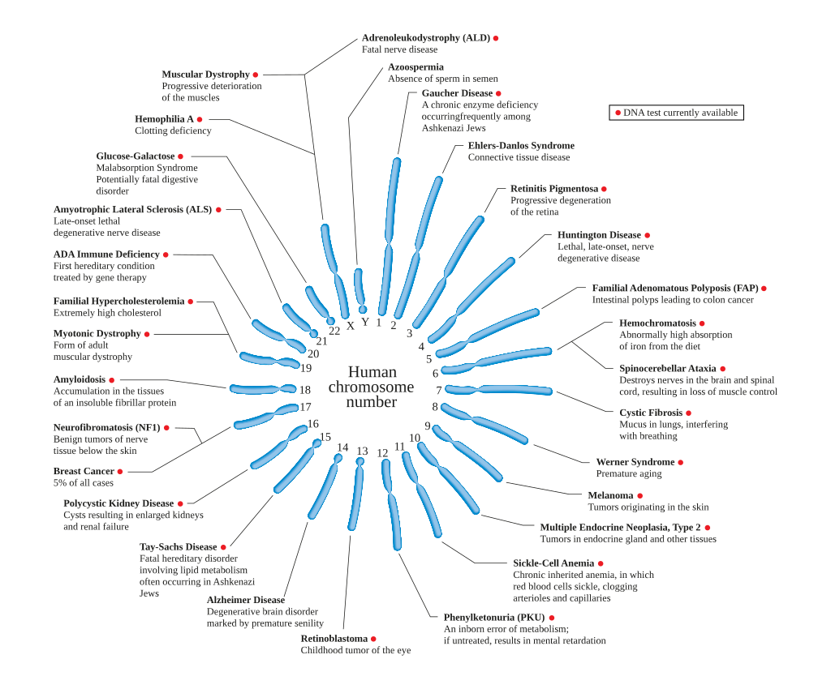

Slide 5
What causes genetic disorders?
Genetic disorders may be caused by problems with either chromosomes or genes.

Slide 6
What is an inherited disorder?
An inherited disorder is caused by defective genes that can be passed down by parent to their children.
Defective genes can occur on any of the chromosome.
A genetic disorder can be autosomal dominant, autosomal recessive or sex linked.

Slide 7
Genetic Disabilities
A genetic disorder is a genetic problem caused by one or more abnormalities in the genome.
Most genetic disorders are quite rare and affect one person in every several thousands or millions.

Slide 8
Children Status of Genetic Disorder
With a very large population and high birth rate, and consanguineous marriage favoured in many communities, there is a high prevalence of genetic disorders in India.
An estimated 495,000 infants with congenital malformations, 390,000 with G6PD deficiency, 21,400 with Down syndrome, 9,000 with β-thalassaemia, 5,200 with sickle cell disease, and 9,760 with amino acid disorders are born each year.
The prevalence of late-onset multi-factorial disorders (including coronary artery disease, hypertension and psychiatric disorders) is also large.

Slide 9
'Indians at a higher risk of rare genetic diseases'
The practice of marrying within the community poses a higher risk of rare diseases among Indians.
As per the estimate from the Ministry of Health and Family Welfare, India could be home to over eight corer persons suffering from rare diseases – an umbrella term used to denote a spectrum of over 5000 diseases usually of genetic origin.

Slide 10
'Indians at a higher risk of rare genetic diseases'
Consanguineous marriages – from same bloodline, practice has made India home to 56 million persons with single gene disorder.
The international estimates suggest that 6-8% of Indians suffer from the problem.
It is said that 80% rare diseases are of genetic origin and hence they disproportionately impact children.
Over 50% of new cases in children are reported each year.
Disease are responsible for 35% death before the age of 1 year, 10% between the ages of 15 years and 12% between 5-15 years.
There is no treatment available for a large number of diseases and on treatment available disease have high cost.

Slide 11
List of Genetic Disorder
Haemophilia
Thalassemia
Sickle-cell anaemia
Primary immuno deficiency
Auto-immuno diseases
Lysosomal storage disorder (such as pompe disease, hirschsprung disease, gaucher’s disease, cystic fibrosis, hemangiomas)
Muscular dystrophies

Slide 12
References
http://timesofindia.indiatimes.com/articleshow/65233813.cms?utm_source=contentofinterest&utm_medium=text&utm_campaign=cppst
https://www.karger.com/Article/Pdf/66335
https://www.ncbi.nlm.nih.gov/pubmed/11262988
https://www.acog.org/-/media/For-Patients/faq094.pdf

