Slide 1
JOHARI Window
Mr. Vijay Sansare
Assistant Professor

Slide 2
Johari window
A simple and useful tool for understanding and training self awareness, personal development, improving communications, interpersonal relationships, group dynamics, team development and intergroup relationships 
Developed by American psychologists Joseph Luft and Harry Ingham in the 1950's, calling it 'Johari' after combining their first names, Joe and Harry
Especially relevant due to emphasis on, and influence of, 'soft' skills, behaviour, empathy, cooperation, inter-group development and interpersonal development

Slide 3
Johari window
Also referred to as a 'disclosure/feedback model of self awareness', and an 'information processing tool' 
Represents information - feelings, experience, views, attitudes, skills, intentions, motivation, etc - within or about a person - in relation to their team, from four perspectives 
Can also be used to represent the same information for a team in relation to other teams

Slide 4
Johari window
Called 'regions' or 'areas' or 'quadrants'. 
Each contains and represents the information - feelings, motivation, etc - in terms of whether the information is known or unknown by the person, and whether the information is known or unknown by others in the team 
The four regions, areas, quadrants, or perspectives are as follows, showing the quadrant numbers and commonly used names

Slide 5
Johari window four regions
Open area, open self, free area, free self, or 'the arena‘: what is known by the person about him/herself and is also known by others –
Blind area, blind self, or 'blindspot‘: what is unknown by the person about him/herself but which others know
Hidden area, hidden self, avoided area, avoided self or 'façade’: what the person knows about him/herself that others do not know
Unknown area or unknown self: what is unknown by the person about him/herself and is also unknown by others

Slide 6
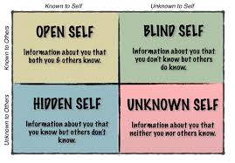

Slide 7
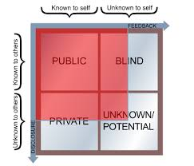

Slide 8
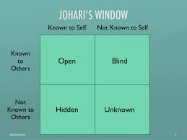

Slide 9
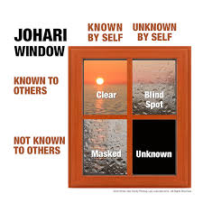

Slide 10
able
accepting
adaptable
bold
black
brave
calm
caring
cheerful
Clever
complex
confident
dependable
dignified
empathetic
energetic
extroverted
friendly
giving
happy
helpful
idealistic
independent
ingenious
intelligent
introverted
kind
knowledgeable
logical
loving
mature
modest
Nervous
complex
observant
organized
patient
powerful
proud
quiet
reflective
relaxed
religious
responsive
searching
self-assertive
self-conscious
sensible
sentimental
shy
silly
spontaneous
sympathetic
tense
trustworthy
warm
wise
witty

Slide 11
Reference
https://www.usc.edu/hsc/ebnet/Cc/awareness/Johari%20windowexplain.pdf (23/08/2016)
http://www.au.af.mil/au/awc/aw/cgate/sgitc/read5.htm (23/08/2016)

