Slide 1
Project Planning, Monitoring & Evaluation
Pradeep Jare

Slide 2
Project Planning: Meaning and importance
After the initiation stage, the project is planned to an appropriate level of detail.
The main purpose is to plan time, cost and resources adequately to estimate the work needed and to effectively manage risk during project execution.

Slide 3
Project Planning: Meaning and importance
Project planning generally consists of
determining how to plan
developing the scope statement;
selecting the planning team;
identifying deliverables and creating the work breakdown structure;
identifying the activities needed to complete those deliverables and networking the activities in their logical sequence;

Slide 4
Project Planning: Meaning and importance
Project planning generally consists of
estimating the resource requirements for the activities;
estimating time and cost for activities;
developing the schedule;
developing the budget;
risk planning;
gaining formal approval to begin work

Slide 5
Monitoring: Meaning and importance
Monitoring and controlling consists of those processes performed to observe project execution so that potential problems can be identified in a timely manner and corrective action can be taken, when necessary, to control the execution of the project.
The key benefit is that project performance is observed and measured regularly to identify variances from the project management plan.

Slide 6
Monitoring
Is Continuous assessment of Project implementation in relation to agreed Schedules( of activities) use of inputs, infrastructure and services by project
Continuous follow up of activities to ensure that they are proceeding according to plan is known as Monitoring
keeping watch on the progress of a project (comparison of the actual with planned activities) and its efficacy (results obtained for the efforts put)

Slide 7
Monitoring Answers the Qs
Measuring the ongoing project activities ('where we are‘, Are we on the right track? If not, why and where did the shift occur?
Are resources( inputs) being utilized in the manner originally envisaged?
What are the issues that need immediate project attention?
What needs to be done next?( corrective actions/revision of plans)
At the output level, examines what the activity achieved, what the project sought & how successful

Slide 8
Monitoring
Provides managers and other stakeholders with continuous feedback on implementation
identifies actual or potential success and problems as early as possible to facilitate timely adjustments/mid-course corrections to project operation
Acts as controlling mechanism

Slide 9
Evaluation
Evaluation is PERIODIC assessment of a project’s Relevance, performance, efficiency and impact in relation to stated Objectives

Slide 10
Evaluation: Meaning and importance
Project evaluation is a systematic and objective assessment of an ongoing or completed project.
The aim is to determine the relevance and level of achievement of project objectives, development effectiveness, efficiency, impact and sustainability.
Evaluations also feed lessons learned into the decision-making process of the project stakeholders, including donors and national partners.

Slide 11
Evaluation
Timely/Episodic assessment of overall achievement and impacts
Systematic way of learning from experience to IMPROVE current activities and promote better planning for future action
Designed specifically with intention to attribute changes to intervention itself
Answers the question, “what have we achieved and what impact have we made”

Slide 12
Why Evaluation? To assess
Relevance: Did the project address our needs/objectives?
Efficiency: Did we use resources wisely?
Effectiveness: Did we achieve the desired results?
Impact: To what extent the project activities brought about changes for the betterment of individuals/communities?
Replicable: Can we repeat the project?
Sustainable: Can we ensure the positive changes CONTINUE?

Slide 13
Key principles in project evaluation
Improve performance and contribute to organizational learning:
Reinforce accountability and transparency;
Form part of a larger dynamic planning and review process;
Are oriented by national and longer term priorities and objectives;
Focus on results and assume that projects are managed for results;
Provide for the participation of national constituents and other partners;

Slide 14
Key principles in project evaluation
Reinforce among our project stakeholders a sense of joint ownership;
Are supported through a highly credible, independent and transparent process;
Confine the process to one which is technically and administratively reasonable;
Are conducted in an ethical way including the responsible handling of confidential information.

Slide 15
Evaluation Criteria
Relevance and strategic fit of the project: The extent to which the objectives of a development intervention are consistent with beneficiary requirements, country needs, global priorities and partner and donor policies.
Validity of project design: The extent to which the project design is logical and coherent

Slide 16
Evaluation Criteria
Project progress and effectiveness: The extent to which the project’s immediate objectives were achieved, or are expected to be achieved, taking into account their relative importance.
Efficiency of resource use: A measure of how economically resources/inputs (funds, expertise, time, etc.) are converted into results.
Effectiveness of management arrangements: The extent to which management capacities and arrangements put in place supports the achievement of results.

Slide 17
Evaluation Criteria
Impact orientation and sustainability of the project: The strategic orientation of the project towards making a significant contribution to broader, long-term, sustainable development changes. The likelihood that the results of the project are durable and can be maintained or even scaled up and replicated by project partners after major assistance has been completed.

Slide 18
Evaluation Report
1. Abstract
2. Brief background on the project and its logic
3. Purpose, scope and clients of evaluation
4. Methodology
5. Review of implementation
6. Presentation of findings regarding project performance
7. Conclusions
8. Recommendations
9. Lessons learned
10. Annexes

Slide 19
Developing monitoring indicators
Objectively verifiable indicators: Indicators that show whether the goal, purpose and results have been achieved, or if the activities have been conducted.
The indicators can be quantitative or qualitative, but must be measurable.
Means of verification: Where can we obtain information on the indicators? Can we use existing sources, or do we have to conduct a survey?

Slide 20
Models and types of evaluation
Models
Participatory & non participatory model
Document based & performance / field based evaluation models
Types
Formal & informal evaluation
Result based (goals / objectives / outcome) & process based evaluation
Internal (self evaluation) & external
Mid term (ongoing / periodical) & final

Slide 21
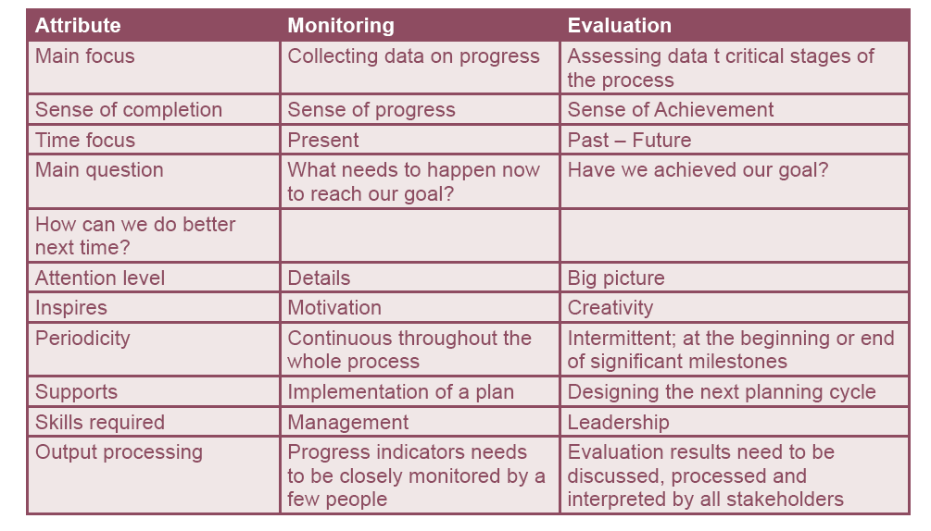
Comparison between Monitoring and Evaluation

