Slide 1
Participatory Rural Appraisal is a family of approaches and methods to enable local people to share, enhance, and analyse their knowledge of life and conditions, to plan, and to act.
-Robert Chambers

Slide 2
History of PRA
In 1970s RURAL RAPID APPRAISAL(RRA) began to emerge as approach and method.
RRA stressed on the use of secondary sources, observation &verbal interaction, semi structured interview, FGDs.
Led to debate on- rapid, non-participatory, used by universities/aid agencies,

Slide 3
Cont..
So in 80s and 90s, RAPID got replaced gradually with PARTICIPATORY got known as PRA which emphasized shared visual representations and analysis by local people, with an objective of empowering the local people specially the poor, by discovering the people’s capabilities for sustainable local action in addition to the methods used by RRA.
Today, they are also further known as PLA or PLM ( Participatory Learning Method) by the practitioners.

Slide 4
What is PRA?
For some, PRA is primarily identified with its distinctive visualization methods- maps, diagrams, charts and so on with and by groups of people in poor communities using local materials on ground and symbols rather than writing.
PRA has to culminate in making action plan in which people define what they would like to change and how they would go about it.
PRA is more than a technique. It is about underlying values and about the attitudes and behaviour of professionals towards those they work with within and beyond an organisation they work for.

Slide 5
Cont…
For some it is an entry point for changing the ways in which development work is done because it directly addresses relationships of power which subordinate local people and local knowledge.
For many, PRA seeks to empower the poor, weak, vulnerable- and to make power reversals real.

Slide 6
Three foundations/pillars
Behaviour and attitudes of outsiders-who facilitate, not dominate- hand over the stick, facilitate, don’t rush
Methods- shift from closed to open, from individual to group, from verbal to visual
Partnership and sharing of information, experience, food and learning between insiders and outsiders

Slide 7
So PRA is-
Participatory
Relevant
Flexible
Rapid and low cost
empowering

Slide 8
Assumptions of PRA
Rural communities form active foundation for rural development
Communities need committed local leaders to stir up their development
Communities have knowledge and information but it needs to be organized
Communities have resources but they need to be mobilized. They can introduce projects, acting primarily on their own resources.

Slide 9
Community organizations are among the many, which are under utilized resources available for development efforts.
Thus, PLA/PRA brings together on the one hand, development needs defined by the community members and on the other, skills of Government, donor agencies and NGOs.
It integrates traditional knowledge systems and external technical knowledge in the development process.

Slide 10
PRA helps communities to…
Mobilize their human and natural resources
Define problems
Consider previous successes and failures
Evaluate priorities and opportunities
Prepare a systematic and site specific plan of action

Slide 11
PRA principles and features
  Respecting people’s knowledge and learning from them.
  Listening to the disadvantaged: Respect
  Optimal ignorance: Do not collect data, which you do not need.
  Flexibility: PRA does not stick to fixed plan to action
  Triangulation: Sources of information change, men, women, different questions
  It involves a team of people working with a community for several days.
  Analysis is done in the field
  Continuity

Slide 12
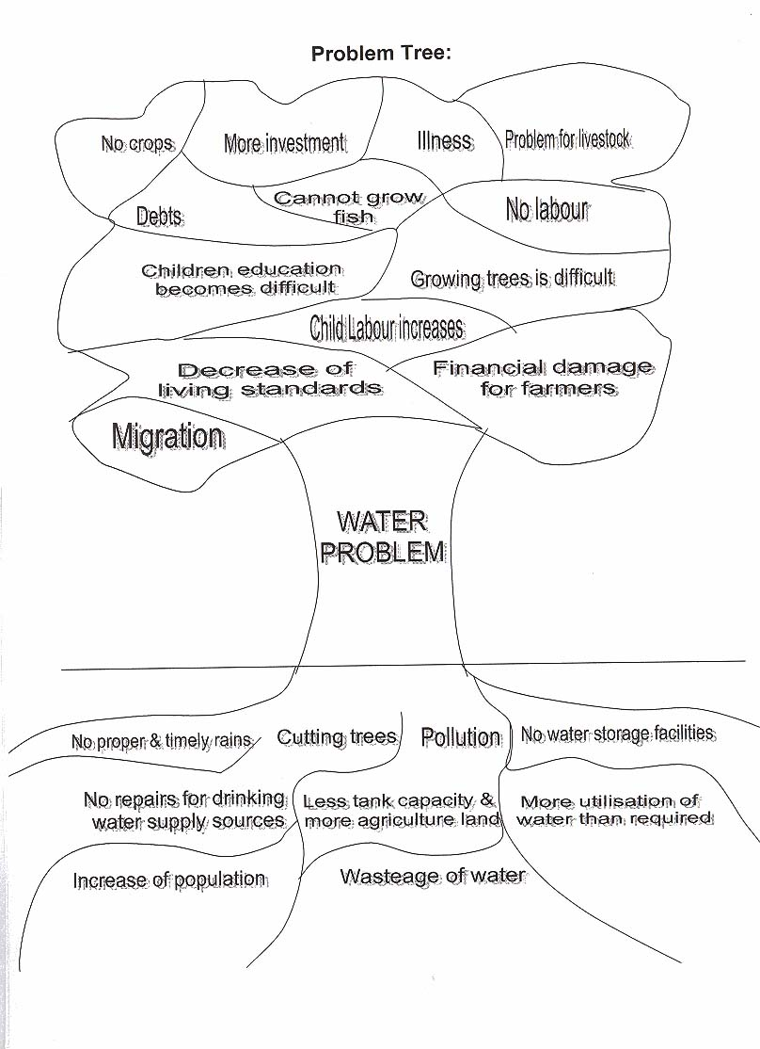
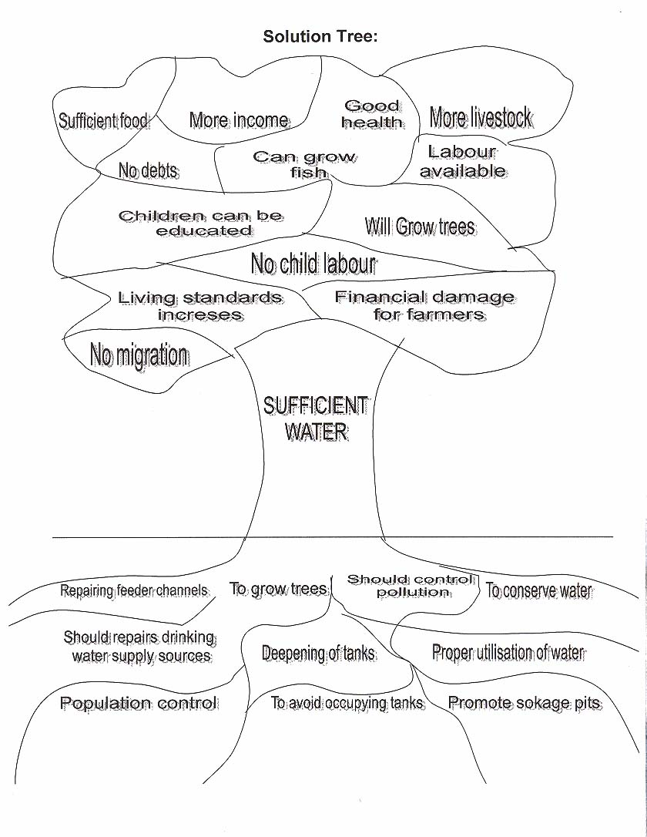
Problem Tree Solution Tree

Slide 13
Tools and Techniques
Transect Walk
Maps and Diagrams-
Social map
Resource map
Seasonal map
Mobility map
Chappati or Venn Diagram
Time line
Daily routine map
Charts
Observation
Semi/unstructured interview
Discussions
Meetings
Ranking/Matrix
others

Slide 14
Role of facilitator
Rapport building
Respectful
abandon preconceptions
Hand over the stick
Watch, listen, learn
learn from mistakes
be self critical and self aware
be flexible
be honest

Slide 15
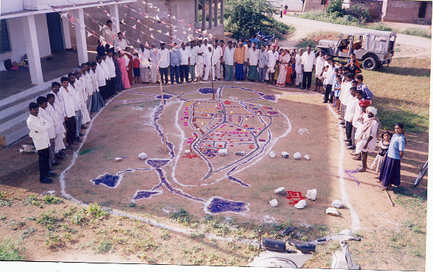
Resource Mapping

Slide 16
DOs
Enjoy the programme and every one else
Spend adequate time planning your PRA
Involve your core team and other members in designing and developing the programme
Visit the village before hand,
Meet key villagers, explain the purpose of the exercise, request their help and support

Slide 17
Cont.
Be clear about the purpose of the exercise
Keep time for the following:
- morning reflection/ write ups/sharing/ briefing/sessions.
- Recreation breaks.
- Night review of day's work and plans for following day
Documentation (written and pictorial) the proceedings,

Slide 18
Cont…
Relax and enjoy the exercise. If things go wrong then as Robert Chambers says `embrace error'.
Create an energy around you so that everyone - the outside participants, the villagers, the women, the children are enjoying themselves and your presence.
Be alert for new things. Either ideas and concepts, or methods, or information. Be creative and inventive, and encourage others to do so

Slide 19
Cont…
Do enlist the support of insiders; school teachers, village elders, youth etc.
Recognise and respect the villagers and their knowledge. Make them feel that what they know is important; old people are the most experienced and knowledgeable. Try sincerely to be a learner for a few days.

Slide 20
Don’ts
Don't rush into things
Don't be over-elaborate or extravagant. Don't make the PRA a `Mela'.
Don't promise people things you cannot give them. Don't raise expectations.
Don't overload/overdo
Don't end up in the trap of endless, irrelevant debates.
Be open but not open ended.

Slide 21
Cont..
Don't delay the documentation bit. If it is not done within three days of the exercise - don't bother to do it - you'll never get it done.
Don't be afraid of making mistakes - provided you learn from them

Slide 22
Cont…
Don’t stick with only one section of the population either and exclude others - unless for a specific purpose.
Don’t exclude the women and children
Don’t allow a “We-They” situation to evolve.
Consciously, keep mixing with the villagers, especially during the evening group presentations, look around and see where your colleagues are positioned, are they scattered with villagers or are they in a group by themselves.
Don’t hesitate to ask villagers for advice
DON’T LECTURE! and DON’T INTERRUPT

Slide 23
PUTTING THE LAST FISRT !!!!!!

