Slide 1
Community Development

Slide 2
Community development is a process where people are united with those of governmental authorities to improve the economic, social and cultural conditions of communities and communities are integrated into the life of the nation enabling them to contribute fully to national progress. – (United Nations, from Biggs, 1999)

Slide 3
Community development is a process, a way of doing things.
It can:
Bring people together
Help people to identify the problems and needs which they share and respond to these
Help people to discover the resources that they already have
Promote knowledge, skills, confidence and the capacity to act together
Strengthen organisation and leadership within communities
Strengthen contacts between communities.

Slide 4
Perspectives On Development

Slide 5
Development as Freedom
Amartya Sen defines Development as,
“A process of expanding the real freedoms that people enjoy”
A process of social change
A Multi-Dimensional Construct
Quantitative as well as Qualitative change
Governed by several factors- (a motive to drive the social change and essential preconditions)
It requires the removal of major sources of unfreedom as systematic social deprivation, neglect of public facilities and so on.

Slide 6
It requires the removal of unfreedom such as tyranny, poor economic opportunities, social deprivation, neglect of public facilities and so on.
‘Freedom’ as a central theme to Development
Freedom to participate in economic interchange: contribution of market mechanisms only after freedom to exchange words, goods and gifts

Slide 7
Freedom to enter markets
Freeing labour from explicit or implicit bondage
Envisaging the role of social support, public regulation and good governance
Economic unfreedom can breed social unfreedom just as social or political unfreedom can foster economic unfreedom

Slide 8
All individuals are endowed with a certain set of capabilities while it is simply a matter of realising these capabilities that will allow a person to escape from poverty and their state of 'unfreedom'.
Income poverty should not be the single most important factor in determining development.

Slide 9
five elemental forms of instrumental freedoms:
Political freedoms,
Economic facilities,
Social opportunities,
Transparency guarantees, and
Protective security

Slide 10
Poverty should be seen "as a deprivation of basic capabilities, rather than merely as low income
According to Sen, development is enhanced by democracy and the protection of human rights. Such rights, especially freedom of the press, speech, assembly, and so forth increase the likelihood of honest, clean, good government

Slide 11
Development is the process of expanding human freedom.
It is “the enhancement of freedoms that allow people to lead lives that they have reason to live”.
Hence “development requires the removal of major sources of unfreedom: poverty as well as tyranny, poor economic opportunities as well as systemic social deprivation, neglect of public facilities as well as intolerance or overactivity of repressive states

Slide 12
The state has a role in supporting freedoms by providing public education, health care, social safety nets, good macroeconomic policies, productivity and protecting the environment.
Freedom implies not just to do something, but the capabilities to make it happen.
People can achieve their capabilities influenced by “economic opportunities, political liberties, social powers, and the enabling condition of good health, basic education, and the encouragement and cultivation of initiatives

Slide 13
Gender and Development
Gender Discrimination
Gender inequality
Gender Imbalance
Gender Division of labour
Patriarchy
Women Empowerment
Gender Needs
Gender mainstreaming
Gender Planning
Gender Budgeting
Gender Analysis

Slide 14
This approach acknowledges that to address women’s concerns and needs,
Development assistance must take account of both women’s and men’s roles and responsibilities within the community and their relationship to each other.
It requires the active participation of men as well as women in order to raise the status of women and bring about sustainable development.
The GAD approach is both strategic and practical, and starts with an examination of issues of power, decision making, work allocation and ownership and control of resources.

Slide 15
Issues & Concerns
Feminization of Poverty: Poverty among women, 70% of the world’s poor are women (UNDP, 1995,).
Declining of Sex ration
Illiteracy among women: male: 82.14% female: 65.46% (2011 census)
Maternal Mortality Rate: 230 deaths/100,000 live births (2008) & 213 (2009)

Slide 16
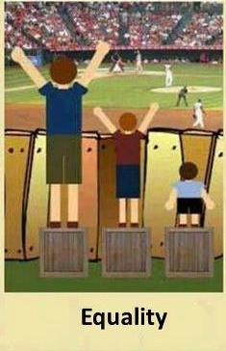
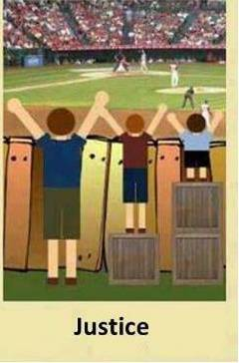
Development as Justice

Slide 17
Development as Justice
Development as establishing a just society with social (economic, political and cultural) equality, removing injustice, social inequalities, discrimination, exploitation, suppression and aggression and the conditions perpetuating unjust living.
Justice means the quality of being just or fair; judgment involved in the determination of rights and the assignment of rewards and punishments
Justice is the concept of moral rightness based on ethics, rationality, law, natural law, religion, fairness, or equity.

Slide 18
Development as Peace and Stability
Stability and peace are essential requirements for development.
Peaceful and stable political situation facilitates social and economic development.
In the context of free economy, development is considered a natural outcome of peace and stability. Therefore, securing political stability and peace is the first step for social and economic development.
No state can progress socially and economically in the absence of stability and peace.

Slide 19
Peace building is a process that facilitates the establishment of durable peace and tries to prevent the recurrence of violence by addressing root causes and effects of conflict through reconciliation, institution building, and political as well as economic transformation

