Slide 1
SWOT originated by Albert s. Humphrey (1960)

Slide 2
It is a tool of understanding your strengths

Slide 3
It is a tool of understanding your weakness

Slide 4
It helps to identify the both opportunities to you and threats you face

Slide 5
Two ways to use
As a simple icebreaker helping people get together to “kick off” strategy formulation
Or
In more sophisticated way as a serious strategy tool

Slide 6
Internal factors: strength and weakness
External factors; Opportunities and threats

Slide 7
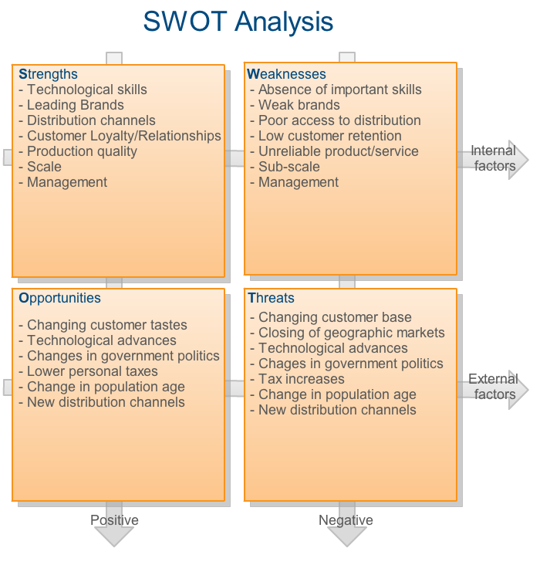

Slide 8
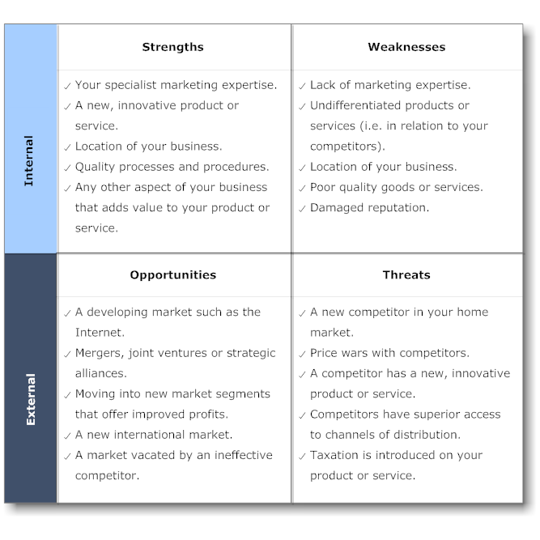

Slide 9
