Slide 1
Transactional Analysis
Mr. Vijay Sansare
Assistant Professor

Slide 2
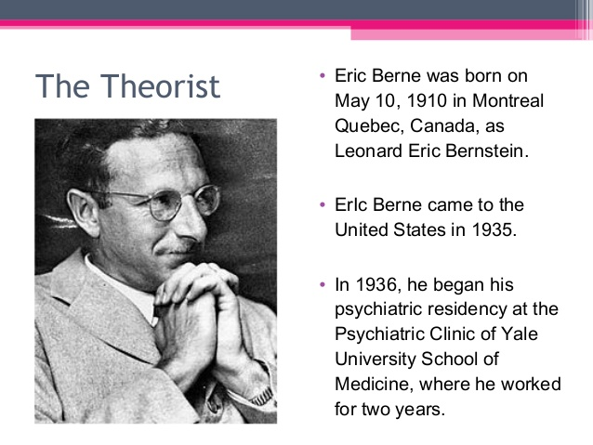

Slide 3
A model for understanding human behavior

Slide 4
Each person is responsible for his/her own feelings, thought, behavior and it can be controlled

Slide 5
Ego states
Ego state as a ‘consistent pattern of feeling and experience directly related to a corresponding consistent pattern of behaviour’
Eric Berne

Slide 6
Ego states
P
Parent ego state
Adult ego state
Child ego state
A
C

Slide 7
Parent Ego states
It is a set of thoughts, feelings and behaviors that are learned or borrowed
It can be divided to two functions
  Nurturing parent ego states
  Critical parent ego or prejudice parent

Slide 8
Adult ego state
It is data processing centre and part of our personality
It processes accurately that sees, hears, thinks and can come up with solutions to problems based on facts

Slide 9
Child ego state
Part of our personality that is a seat of emotions, thoughts, feelings
Memories from our childhood (feelings and experiences)
Behavior patterns

Slide 10
Child ego state
The free child ego state (natural child)
  Seat of spontaneous feelings and behavior
  The side of experiences
  It can playful, authentic, expressive and emotional
  It is essential for good relations and self understanding
Adapted child ego state (rebellious)
  Learned to comply with parents message received for growth
  It a response to parents messages

Slide 11
How recognize what ego state your are in?
By paying attention to…
  Tone
  Body posture
  Gestures
  Choice of word
  Emotions

Slide 12
Ego states example
Nurturing parent:
  Go ahead, play and have a fun!
Critical parent:
  Now, don’t you DARE get yourself all messy!
Adult
  This sand looks really interesting. I can make a castle.
Free child
  Wow! Look how tall my castle is!!!!
Adopted child
  I better not get my clothes all dirty.
Rebellious child:
  I don’t care if I do get dirty.

Slide 13
Stroke
A unit of human recognition
A stroke can be a look, nod, a smile, a spoken word, touch
Stroke can be positive and negative
  I love you … I hate you …..

Slide 14
Life script and Early decision
A life script is an unconscious life span based on decisions made in early childhood about ourselves, others, and our lives….

Slide 15
Existential positions
Based on the messages received and decisions made, a young child develops a basic positions.

Slide 16
TA
Transactions about how people interact with each other specifically, which ego state is talking to which ego state in you…..

Slide 17
Ta in your life ….
Can help you understand your self better
See more clearly how you interact with others
It believes that we are each responsible for our future

Slide 18
Existential Positions
I'm OK, You're OK
  If things go well
I'm OK, You're Not OK
  Treated badly or abused
I'm Not OK, You're OK
  If child not cared and decreases his values due script
  I'm Not OK, You're Not OK
  When things go really wrong

Slide 19
Thank you!!!

