Slide 1
Theoretical Assumption underlying Social Group Work Mr. Vijay Sansare Assistant Professor

Slide 2
Theories applicable to group work practice
Psychoanalytical theory
Learning theory
Field theory
System theory
Conflict theory
Exchange theory

Slide 3
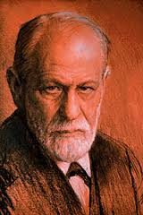
Sigmund Freud was an Austrian neurologist and the father of psychoanalysis, a clinical method for treating psychopathology through dialogue between a patient and a psychoanalyst.
Born: May 6, 1856, Príbor, Czech Republic
Died: September 23, 1939, Hampstead, United Kingdom
Influenced: John Bowlby, Viktor Frankl, Anna Freud, Ernest Jones, more
Fields: Neurology, Psychology, Psychotherapy, Psychoanalysis

Slide 4
Psychoanalytic Theory.
The id, ego, and superego are names for the three parts of the human personality which are part of Sigmund Freud’s psychoanalytic personality theory.
According to Freud, these three parts combine to create the complex behavior of human beings.

Slide 5
Psychoanalytical theory

Slide 6
Psychoanalytical theory
Sigmund Freud believed that behaviour and personality derives from the constant and unique interaction of conflicting psychological forces that operate at three different levels of awareness: the preconscious, the conscious, and the unconscious.

Slide 7
Psychoanalytical theory
Three levels of mind
Conscious – awareness
Preconscious – ordinary memory
Unconscious - outside of our conscious awareness

Slide 8
Psychoanalytical theory
Id: Meeting Basic Needs
The id is the most basic part of the personality, and wants instant gratification (तृप्ति) for our wants and needs. If these needs or wants are not met, a person becomes tense or anxious.

Slide 9
Psychoanalytical theory
Ego: Dealing with Reality
The ego deals with reality, trying to meet the desires of the id in a way that is socially acceptable in the world.
This may mean delaying gratification, and helping to get rid of the tension the id feels if a desire is not met right away.
The ego recognizes that other people have needs and wants too, and that being selfish is not always good for us in the long run.

Slide 10
Psychoanalytical theory
Superego: Adding Morals
The superego develops last, and is based on morals and judgments about right and wrong.
Even though the superego and the ego may reach the same decision about something, the superego’s reason for that decision is more based on moral values, while the ego’s decision is based more on what others will think or what the consequences of an action could be.

Slide 11
Psychoanalytical theory
Three status of mind
Id - Pleasure Principle (Primary Process)
Ego – Reality Principle – Secondary Process (balancing, conscious & unconscious mind )
Superego – internalized moral standards and ideals

Slide 12
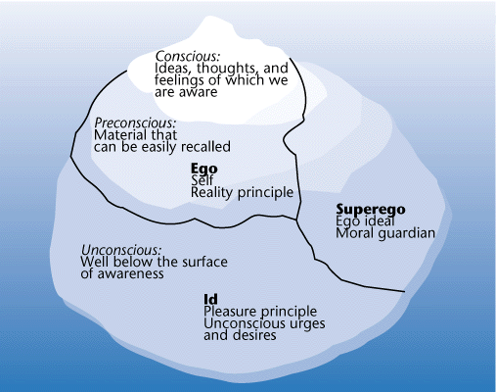
Born

Slide 13
Psychoanalytical theory
http://psychology.about.com/od/theoriesofpersonality/a/consciousuncon.htm
http://examples.yourdictionary.com/examples/examples-of-psychoanalytic-theory.html

Slide 14
Social Learning Theory
Albert Bandura – 1977
Most influential theory of learning and development
Added a social element - people can learn new information and behaviours by watching other people
Three core concepts …..

Slide 15
Social Learning Theory
1. People can learn through observation
Observational Learning
Bobo Doll Experiment - two different adult models; an aggressive model and a non-aggressive one
A live model
A verbal instructional model
A symbolic model

Slide 16
Social Learning Theory
2. Mental states are important to learning
Intrinsic (वास्तविक) Reinforcement (प्रबलीकरण)
as a 'social cognitive theory’

Slide 17
Social Learning Theory
3. Reinforcement leads to strengthen the behaviour in group

Slide 18
Social Learning Theory
The Modeling Process & observational learning
Attention (सावधान स्थिति)
Retention (स्मरण)
Reproduction (प्रतिकृति)
Motivation (अभिप्रेरणा)

Slide 19
Social Learning Theory
Operant Conditioning - is simple learning through punishment and reward
Classical Conditioning - is paired stimulus learning

Slide 20
Social Learning Theory
http://psychology.about.com/od/developmentalpsychology/a/sociallearning.htm (29.08.2013)

Slide 21
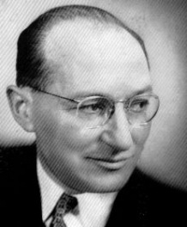
Field Theory (1946)
Kurt Lewin
Born in Mogilno, Prussia in 1890
Immigrated to the US after Hitler
took power in 1933
Considered the "father of social psychology"
Died from a heat attack at age 56

Slide 22
Field Theory (1946)
In Kurt Lewin’s words, ‘to understand or to predict behaviour, the person and his environment have to be considered as one constellation (group of stars) of interdependent factors’.

Slide 23
Field Theory (1946)
Field theory in sociology examines how individuals construct social fields, and how they are affected by such fields

Slide 24
Field Theory (1946)
Social fields are environments in which competition between individuals and between groups takes place, such as markets, academic disciplines, musical genres, etc.

Slide 25
Field Theory (1946)
Studied leadership styles by creating a group with different style of leadership
Commonly observed that leader becomes authoritarian (अधिकारवादी)
Leadership style is a product of member interaction rather than personality traits

Slide 26
Field Theory (1946)
Group has life span & movements and looks for achieving goals & faces hurdles in movement (locomotion - गति)
Behavior of individual & group as a product of totality (समग्रता) of the group situation

Slide 27
Field Theory (1946)
Introduced concepts to learn forces of work in groups
Roles
Norms
Power
Cohesion (लगाव)
Valence (संयोजन क्षमता)

Slide 28
Field Theory (1946)
Cohesion as important factor – ‘the totality of forces acting on individual members to keep them in the group
T groups – to observe the group process

Slide 29
Field Theory (1946)
For example, your decision to take up a course of study may be influenced by your own interests and abilities, your parents' wishes, your financial capability, your friends' opinions, and other factors.

Slide 30
Field Theory (1946)
http://www.alleydog.com/glossary/definition.php?term=Kurt%20Lewin#ixzz2dfSTcXEa

Slide 31
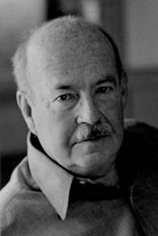
System Theory (1951)
Talcott Parsons (December 13, 1902 – May 8, 1979) was an American sociologist who served on the faculty of Harvard University from 1927 to 1973.

Slide 32
System Theory (1951)
It is set of interdependent elements trying to function as a unified whole to maintain order and a stable equilibrium
Systems are constantly faces challenges due to the surrounding environment

Slide 33
System Theory (1951)
Functioning of group
Integration
Adaptation
Pattern maintenance
Achievement of goal

Slide 34
THANK YOU ……..

