Slide 1
Unit -1:
Concept, Meaning, Evolution and approaches of CSR in India

Slide 2
Meaning
Corporate – Large companies or corporations, big groups or businesses, commercial organisation that operates on a profit basis.
(Industries, factories, companies, offices, banks, hospitals etc)
Social – Relating society or relating to human society and its modes of organization, social classes, social problems or social issues
Responsibility – Something that is individuals duty to perform, duty to deal something, being accountable or answerable

Slide 3
Contd…..
Organisation – Receives inputs from society eg. Skilled/unskilled labour, raw material and natural resources
Business depend on society for their existence
Businesses/ Industries cannot existence in isolation or in a vacuum
Industrial growth or business – provide employment opportunities, contribute to socio-economic development
Adversely brings social problems like displaces people, depletion of natural resources, environment pollution etc

Slide 4
Stakeholders
Stakeholders – Individuals or groups who either get advantage or disadvantaged by corporate decision or action
Primary stakeholders
Shareholders
Business partners
Bankers, lenders and Insurers
Employees
Customers
Communities
Future generations
The natural environment

Slide 5
Stakeholders
Secondary Stakeholders
Local or State government
Regulatory bodies
Civic institutions
Media
Competitors
(Business and Society: Ethics and Stakeholder Management, Archie Carroll and Ann Buchholtz)
Stakeholder theory focus was “for whose benefit and at whose expense should the firm be managed” (Evan & Freeman 1988)

Slide 6
Definitions
‘Ethical behaviour of a company or business towards society’
Corporate Social Responsibility is the continuing commitment by business to behave ethically and contribute to economic development while improving the quality of life of the workforce and their families as well as of the local community and society at large.
(The World Business Council for Sustainable Development)

Slide 7
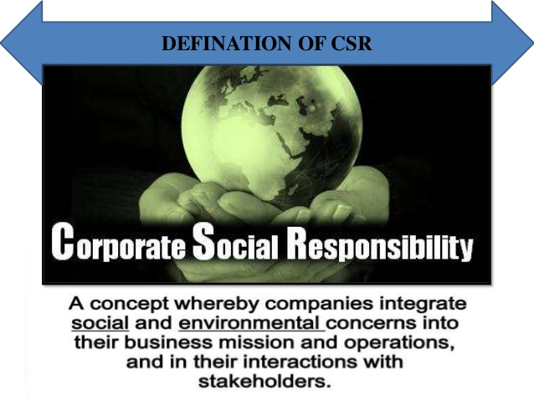
Definition of CSR

Slide 8
Definition
Corporate social responsibility (CSR) is a business approach that contributes to sustainable development by delivering economic, social and environmental benefits for all stakeholders.
Social responsibility is the responsibility of an organisation for the impacts of its decisions and activities on society and the environment, through transparent and ethical behaviour that:
  Contributes to sustainable development, including the health and the welfare of society
  Takes into account the expectations of stakeholders
  Is in compliance with applicable law and consistent with international norms of behaviour, and
  Is integrated throughout the organization and practised in its relationships.”
  Guidance Standard on Social Responsibility, ISO 26000, published in 2010.

Slide 9
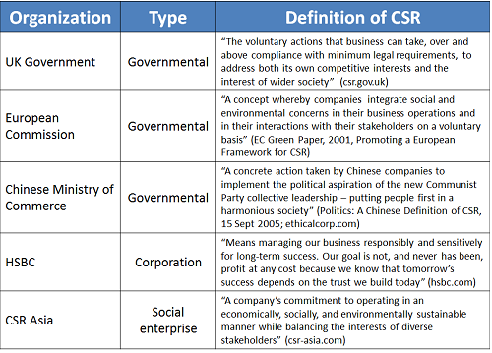
Definitions of CSR (Different Countries)

Slide 10

Elements of CSR – Elkington’s model

Slide 11
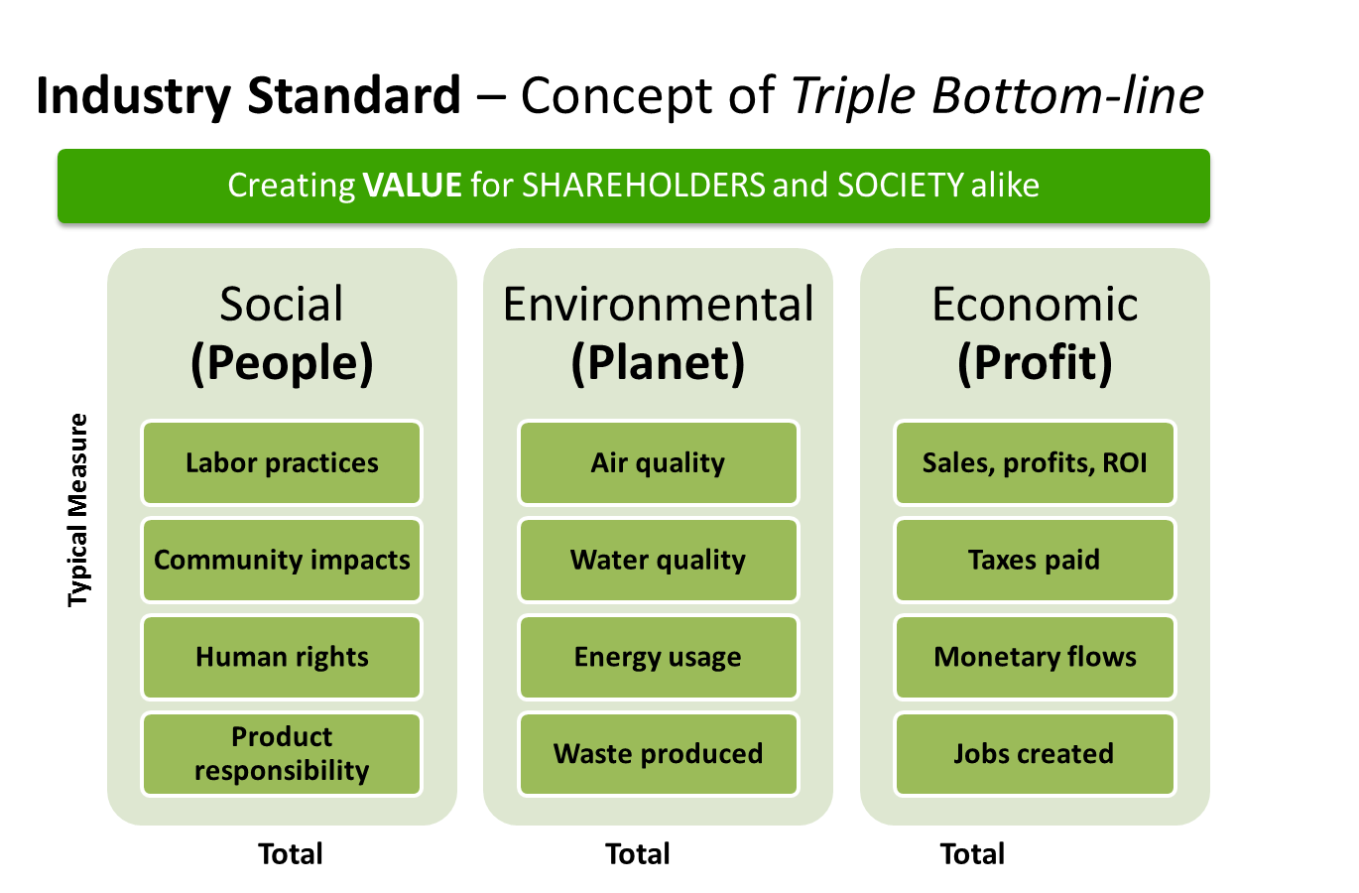
Triple Bottom Line

Slide 12
Drivers of CSR
Economic considerations
Ethical considerations
Innovations
Employee motivation
Access to capital or increased shareholder value
Reputation or brand
Improvement in market position
Improved relationships with supplier, government authorities

Slide 13
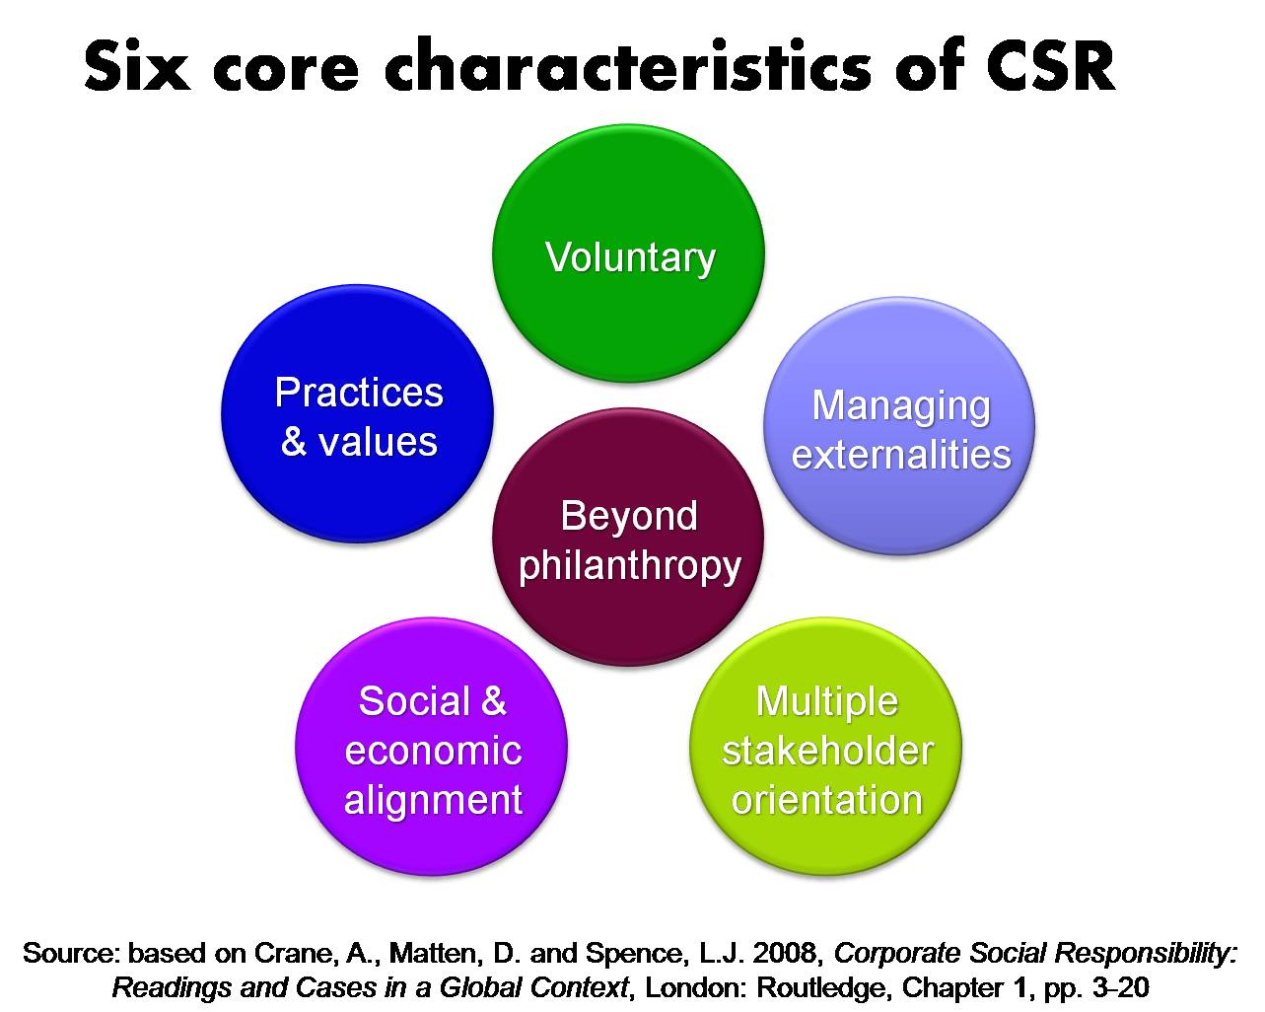
Characteristics of CSR

Slide 14
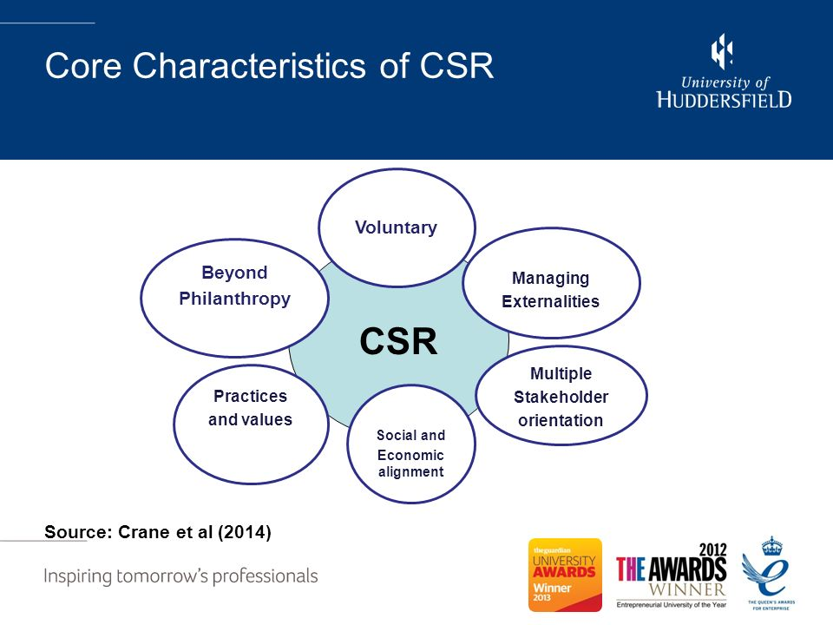
Characteristics of CSR

Slide 15
Differences in CSR among large and small firms
Large scale industries
Formal, bureaucratized
Shareholders and external stakeholders
Build corporate image and brand, manage public legitimacy
SME’s
Informal
Owner-manager, employees
Build trust, personal relations and networks

Slide 16
Principles of CSR
Sustainability –
Sustainability is concerned with the effect which action taken in the present has upon the options available in the future.
Finite resources/ depletion of resources
Sustainability therefore implies that society must use no more of a resource than can be regenerated
Accountability –
Accountability is concerned with an organisation recognising that its actions affect the external environment
a reporting to external stakeholders of the effects of actions taken by the organisation and how they are affecting those stakeholders.

Slide 17
Contd……
Transparency -
Information is freely available and directly accessible to those who will be affected by such decisions and their enforcement
Importance to external users of such information as these users lack the background details and knowledge available to internal users of such information
The process of recognition of responsibility on the part of the organisation for the external effects of its actions - reveal information related to such matters as its objectives, missions and visions

Slide 18
Benefits of CSR
CSR improves financial performance
CSR improves brand image & reputation
CSR wins new business
CSR helps for operational costs savings
CSR helps to develop and enhance relationships with customers, suppliers and networks
CSR increases the ability to attract & retain employees
CSR increases customer loyalty
CSR leads to reduced regulatory oversight
CSR facilitates organisational growth

Slide 19
Historical Perspective
Business involvement in social welfare and development has been a tradition in India
Its evolution from individuals' charity or philanthropy to Corporate Social Responsibility, Corporate Citizenship and Responsible Business can be seen in the business sector over the years
Parting with a portion of one's surplus wealth for the good of society is neither modern nor a Western
The concept of social responsibility among businessmen is not new
Strong tradition of charity in almost all the business communities of India has acquired a secular character
Temples, dharmashalas, mosques, educational institutions and hospitals
Religion – charity, philanthropy, donations, zakat

Slide 20
Contd……
India's leading businessmen were influenced by Mahatma Gandhi and his theory of trusteeship of wealth contributed liberally to his programmes for removal of untouchability, women's emancipation and rural reconstruction
Industrialisation – After 1850
  Phase 1 – Corporations were responsible for owners and managers
  Phase 2 – Owners, managers and employees
  Phase 3 – Owners, managers, employees and environment
  Phase 4 – Owners, managers, employees, environment and public at large

Slide 21
National Voluntary Guidelines on Social, Environmental and Economic Responsibilities of Business
Corporate Social Responsibility Voluntary Guidelines 2009, released by the Ministry of Corporate Affairs in December 2009
To implement & encourage business to adopt tri[le bottom line approach
NVGs are applicable to all business irrespective of size, sector & location
Principle 1: Business should conduct and govern themselves with ethics, transparency and accountability
Principle 2: Business should provide goods and services that are safe and contribute to sustainability throughout their life cycle
Principle 3: Business should promote the well-being of all employees

Slide 22
Contd….
Principle 4: Business should respect the interests of and be responsive to al stakeholders especially who are disadvantaged, vulnerable and marginalised
Principle 5: Business should respect and promote human rights
Principle 6: Business should respect, protect and make efforts to restore the environment
Principle 7: Business when engaged in influencing public and regulatory policy, should do so in a responsible manner
Principle 8: Business should support inclusive growth and equitable development
Principle 9: Business should engage with and provide value to their customers and consumers in a responsible manner

