Slide 1
UNIT 1 FUNDAMENTALS OF MANAGEMENT
CONCEPT, NATURE AND ELEMENTS OF MANAGEMENT

Slide 2
Organisation
A social unit of people that is structured and managed to meet need or to pursue collective goals.
An organised group of people with a particular purpose, such as a business or government department
A group of people who work together in an organized way for a shared purpose
Formal and informal organisation, government or private
Business organisation- Sole proprietorship, partnership and corporations

Slide 3
Important elements of an organisation
Factors of production- Land, labour, capital and entrepreneur
The six M’s management
Men/women
Money
Material
Machine
Method
Market

Slide 4
Definition of Management
‘Management is the art of knowing what you want to do and then seeing that it is done in the best and cheapest way’- F.W.Taylor
‘To manage is to forecast and to plan, to organise to command, to coordinate and to control’ – Henry Fayol
‘Management is a multipurpose organ that manage a business and manages Managers and manages Workers and work’ – Peter Drucker
‘Management is an art of getting things done through and with people in formally organised groups’

Slide 5
Characteristics of management
Management is goal oriented
Management is universal
Management is a continuous process
Management is an integrative process
Management is a social process
Management is multidisciplinary
Management is intangible
Management is situational

Slide 6
Nature of Management
The term management has been interpreted as,
Management as an activity – interpersonal activities, decisional activities and informative activities
Management as a process – It involves series of interrelated functions (planning, organising, staffing, coordinating etc)
Management as a group – Group of persons (top, middle and lower)
Management as an academic discipline – A specialised and systematic body of knowledge

Slide 7
Contd….
Management is a science as well as an art -
Science refers to a systematic body of knowledge with reference to understanding of some phenomenon or subject or object of study.
It establishes a cause and effect relationship between variables. It is based on systematic explanation, experimental analysis, critical evaluation and logical consistency
As an art it requires certain personal skills, practical knowledge, creativity
Management as Profession – Acquisition of knowledge through formal education, professional conduct, financial reward

Slide 8
Levels of Management
There are certain levels of management with varying degree of authority and responsibilities.
It can be divided into three categories:
Top-Level Management
Middle-Level Management
Lower-Level Management

Slide 10
Levels of management

Slide 11
Levels of management

Slide 12
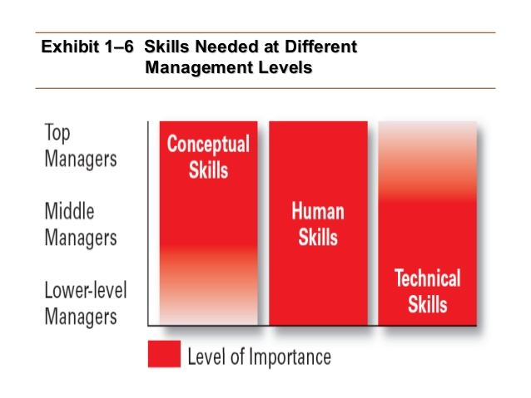
Skills of management
Conceptual skills
Human skills
Technical skills

Slide 13
Importance of management
Optimum utilisation of resources
Efficiency and effectiveness
Change and development
Reduces cost
Attainment of goals
Stability and growth
Establish sound organisation

Slide 14
Henry Fayol

Slide 15
Henri Fayol (1841 – 1925)- Fayolism
Henri Fayol was a French coal-mine engineer, director of mines and modern management theoretician
First foundations were laid for modern scientific management
They are drawn up by means of observations and analyses of events that managers encounter in practice
These principles of management serve as a guideline for decision-making and management actions.
The underlying factors for successful management

Slide 16
Principles of management
Henri Fayol listed 14 principles of Management,
1. Division of work – Employees are specialised in different areas and they have different skills. Specialisation promotes efficiency of the workforce and increase productivity. Accuracy and speed. This principle is applicable to managerial and technical activities
2. Authority and responsibility – Authority is a combination of official factors which are deriving from managerial position. These two terms are interrelated, go together, responsibility arising from authority
3. Discipline – Good conduct and respectful interactions. Respect for agreements which are directed at achieving obedience, application. Requires good supervision at all levels

Slide 17
Contd…..
4. Unity of command – Employees should receive orders from one manager or supervisor only and that the employee is answerable to that manager. No confusion, no conflict and responsibility for mistakes can be established
5. Unity of direction – Each group of activities with the same objective must have one head and one plan
6. Subordination- Subordination of individual interest. There are all kinds of interests in an organisation. Personal interest are subordinate to the interests of the organisation.
7. Remuneration – Remuneration and methods of payment should be fair and afford the maximum possible satisfaction to employees and employers

Slide 18
Contd…..
8. Centralisation – Management and authority for decision making process must be properly balanced in an organisation. It refers to the extent to which authority is concentrated or dispersed. Sharing authorities with lower levels- decentralisation
9. Secular chain – Hierarchy (management structure) presents itself in any given organisation. It varies from senior levels to the lowest levels. There should be clear line in the area of authority, should be short circuited
10. Order – Arrangement of things and people. Employees should have the right resources at their disposal so that they can function properly in an organisation
11. Equity – Employees must be treated kindly and equally. Managers should treat employees fairly and impartially

Slide 19
Contd…..
12. Stability of tenure – For higher motivation and morale there should be job security. Management should strive to minimise employee turnover
13. Initiatives – Employees should be allowed to express their ideas. Employees initiatives are a source of strength for the organisation. This encourages interest and involvement and creates added values for the company.
14. Esprit de corps – In union there is strength. It emphasises the need for teamwork, involvement and unity of the employees. Esprit de corps contribute to the development of culture and create an atmosphere of mutual trust and understanding

Slide 20
Frederick Winslow Taylor (1856-1915) – Father of Scientific Management

Slide 21
Scientific Management
Frederick Winslow Taylor was an American mechanical engineer
One of the first management consultants
Experience from the bottom-most level in the organization - first the problems of the workers
Taylor saw productivity as the answer to both higher wages and higher profits.
Increasing efficiency in production, not only to lower costs and raise profits but also to make possible increased pay for workers through their higher productivity.
F. W. Taylor devised his system and published "Scientific Management" in 1911.

Slide 22
Principles of Scientific management
Science, Not Rule of Thumb
Rule of Thumb means decisions taken by manager as per their personal judgments
Intuition or hit and trial methods
Best way of performing a job through the application of scientific analysis
Small production activity can be scientifically planned. This will help in saving time as well as human energy
Decisions should be based on scientific enquiry with cause and effect relationships

Slide 23
Contd…..
2. Harmony, Not Discord
Complete harmony between the workers and the management
Conflict – not beneficial
Perfect understanding between the management and workers, the importance of each other
Produce synergy effect since both management and workers work in unison
Prosperity for an employer cannot exist for a long time unless it is accompanied by the prosperity of the employees of that organisation and vice versa

Slide 24
Contd…..
3. Mental Revolution
A change in the attitude of workers and management towards each other
Mental revolution requires a complete change in the outlook of both management and workers.
There should be a spirit of togetherness between workers and management.
Management as well as the workers should aim to increase the profits of the organisation

Slide 25
Contd…..
4. Cooperation, Not Individualism
An extension of principle of ‘Harmony, not discord’
Cooperation, mutual confidence, sense of goodwill should prevail among both, managers as well as workers
Management - decision making process of the management, welcome their suggestions, reward
Workers - resist from going on strike or making unnecessary demands from management

Slide 26
Contd…..
5. Development of each and every person to his or her greatest efficiency and prosperity
Scientifically designed procedure for the selection of workers
The work - physical, mental and intellectual capabilities
Efforts should be made to develop each employee to his greatest level and efficiency & prosperity
Training – best method
To attain efficiency and prosperity for both organisation and the employees.

